Slide 1

EasyWay
Deliverable 4
Subject: CS691
Computer Science Project 1
Designed By:
Vidisha Vijay Sawant

Slide 2

Agenda

Slide 3
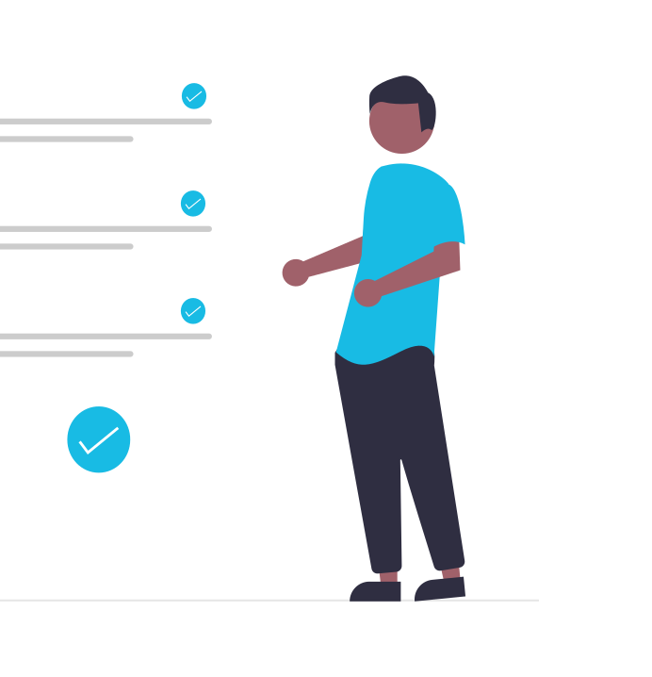
Agenda
Improvement from Professor’s Feedback
Problem Statement
Project Description
Personas
MVP
Technologies
Architecture Diagram
Sprint 3 Recap
Product Backlog
Sprint Backlog
Metrics
Retrospective
Sprint 5
Project Demo
Live Application Demo

Slide 4
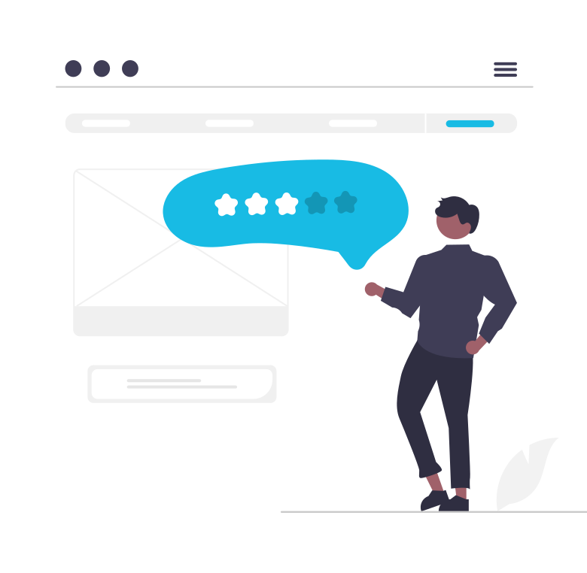
Professor Feedback from the previous deliverable
Add ER database diagram.
In the burndown chart use story points instead of issue count.

Slide 5

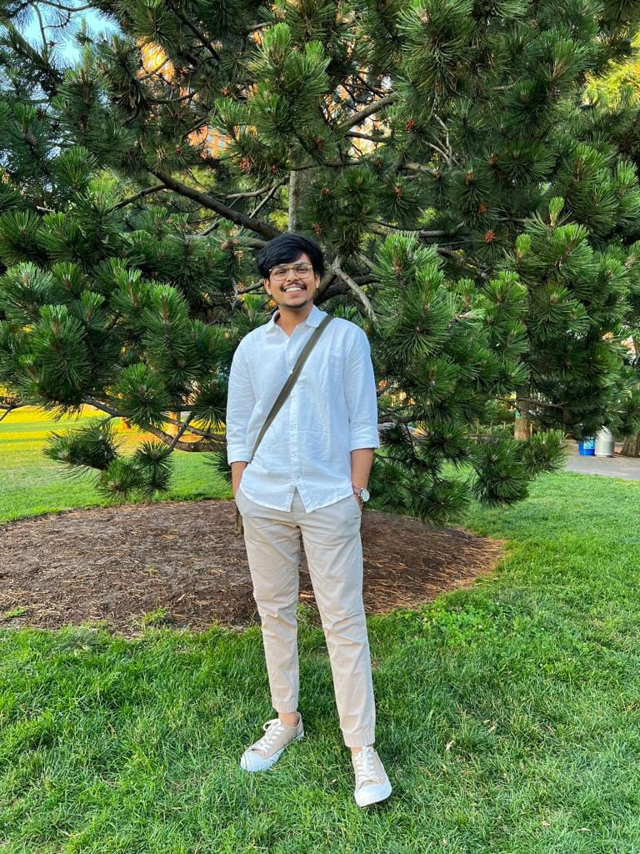

Team Member Roles
Aditya Kadarla
Project Manager
Quality Analyst & Tester
Shubham Sawant
Business Analyst & Developer
Ravi Kumar Dabbada
Database Administrator

Slide 6

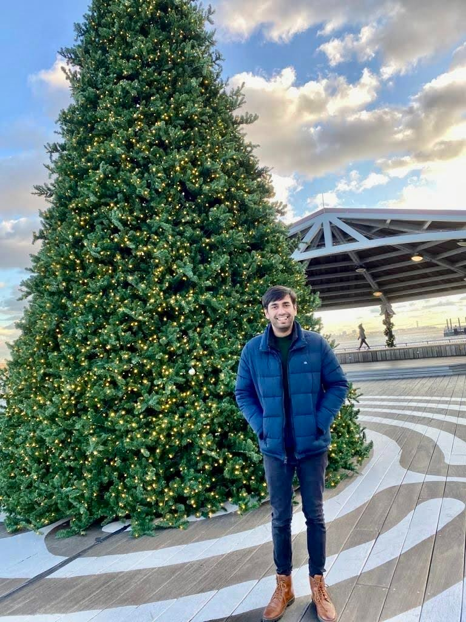
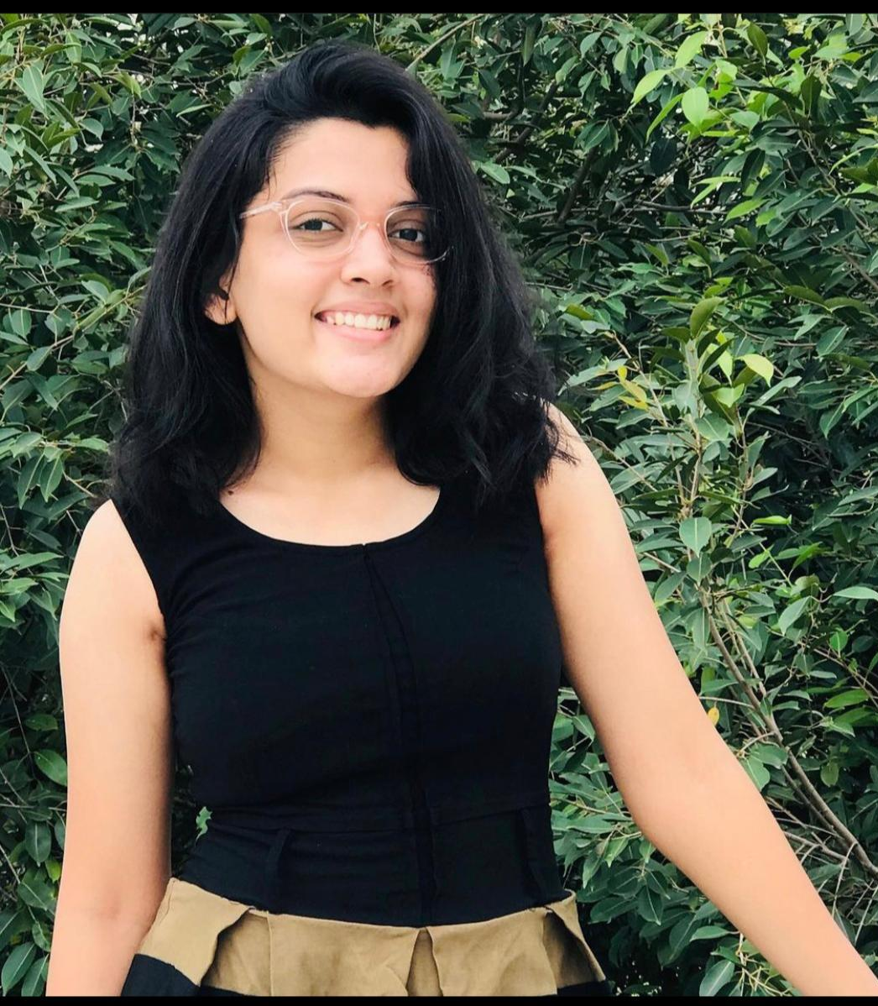
Team Member Roles
Vidisha Vijay Sawant
Developer
Kshitij Sharma
Developer
Femina Baldha
Developer

Slide 7

Problem Statement
Home services are an age-old concept. The “old way” of availing local home services was for servicemen (“handymen”) to market themselves through word of mouth, and then to use listing services such as Yelp. Local home services are inherently disorganized, with individuals usually running business operations. Services range from carpentry, plumbing, beauty, laundry, and so on. Think of anything you need in your home, that can’t be solved by buying a product. That is likely going to be solved by home services.
The trouble is, home services are not a commodity.
The core reason why people continued to rely on word of mouth after bad experiences, was because it was impossible to tell what you were getting into, even for something as “basic” as plumbing. How do you know the carpenter is good, or the plumber will do a good job? Sure, the industry is ripe for disruption, but how would it get disrupted?

Slide 8

Project Description
The “EasyWay" web application aims to aggregate utility services such as beauty, electrical maintenance, home cleaning, pest control, etc. The application would enable the end-user to select their preferred service, book an appointment at a convenient time, pay the resultant charge and give feedback. The application aims to be a one-stop shop that caters to all the utility needs of the end user. Our product promises easy booking and cancellation without extra changes, and you can maintain your booked services in one place easily.

Slide 9

Personas

Slide 10
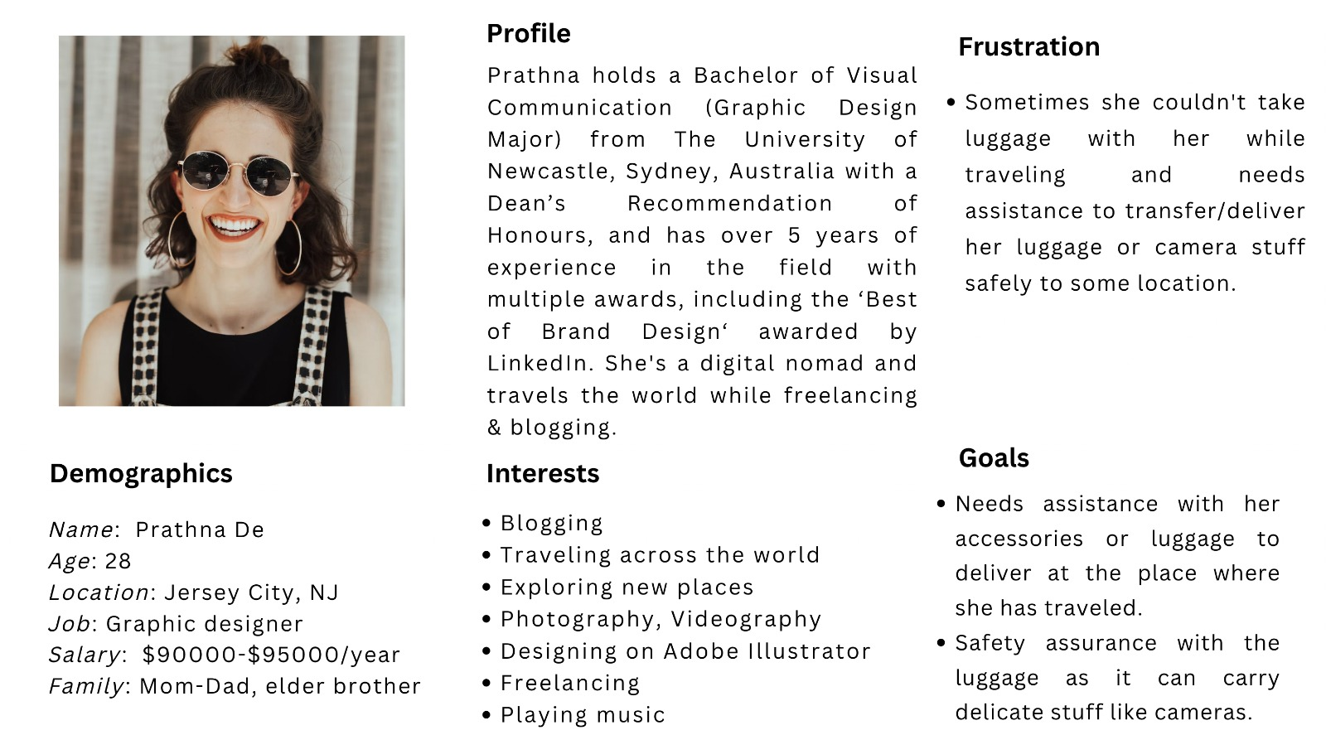
Persona 1

Slide 11
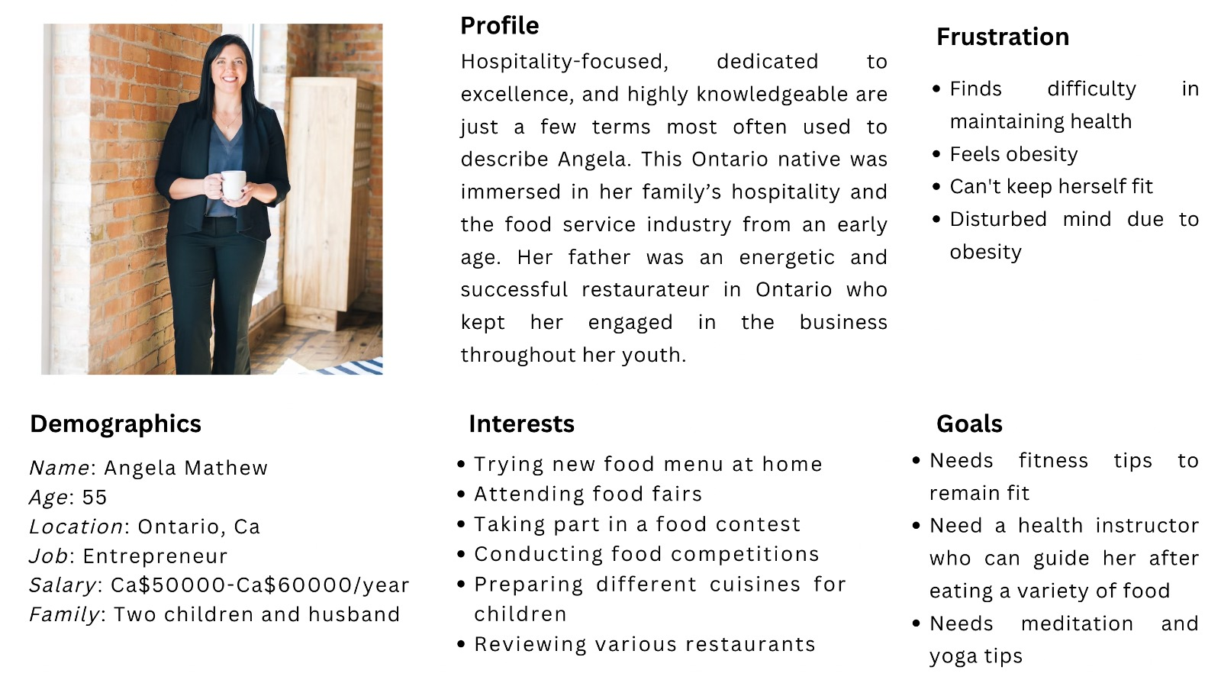
Persona 2

Slide 12
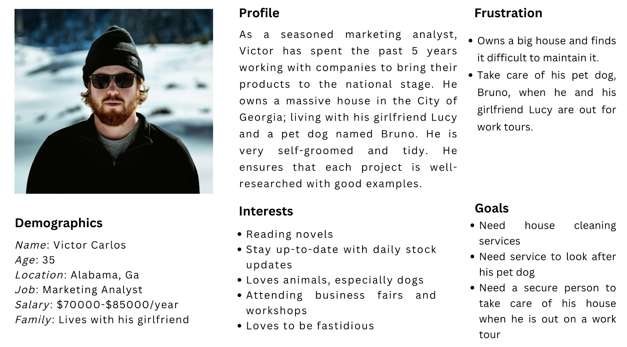
Persona 3

Slide 13

MVP (Minimum Viable Product)

Slide 14

Minimum Viable Product (MVP)
1: Homepage
2: Service Catalog
3: Cancel Booking
4: Registration – Customer and Professional
5: Login - Customer and Professional
6: Book – Calendar and Time
7: Booking Confirmation via email or in-app

Slide 15

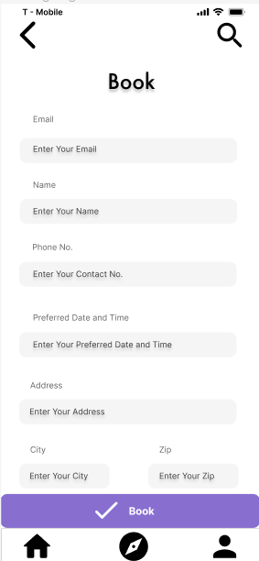
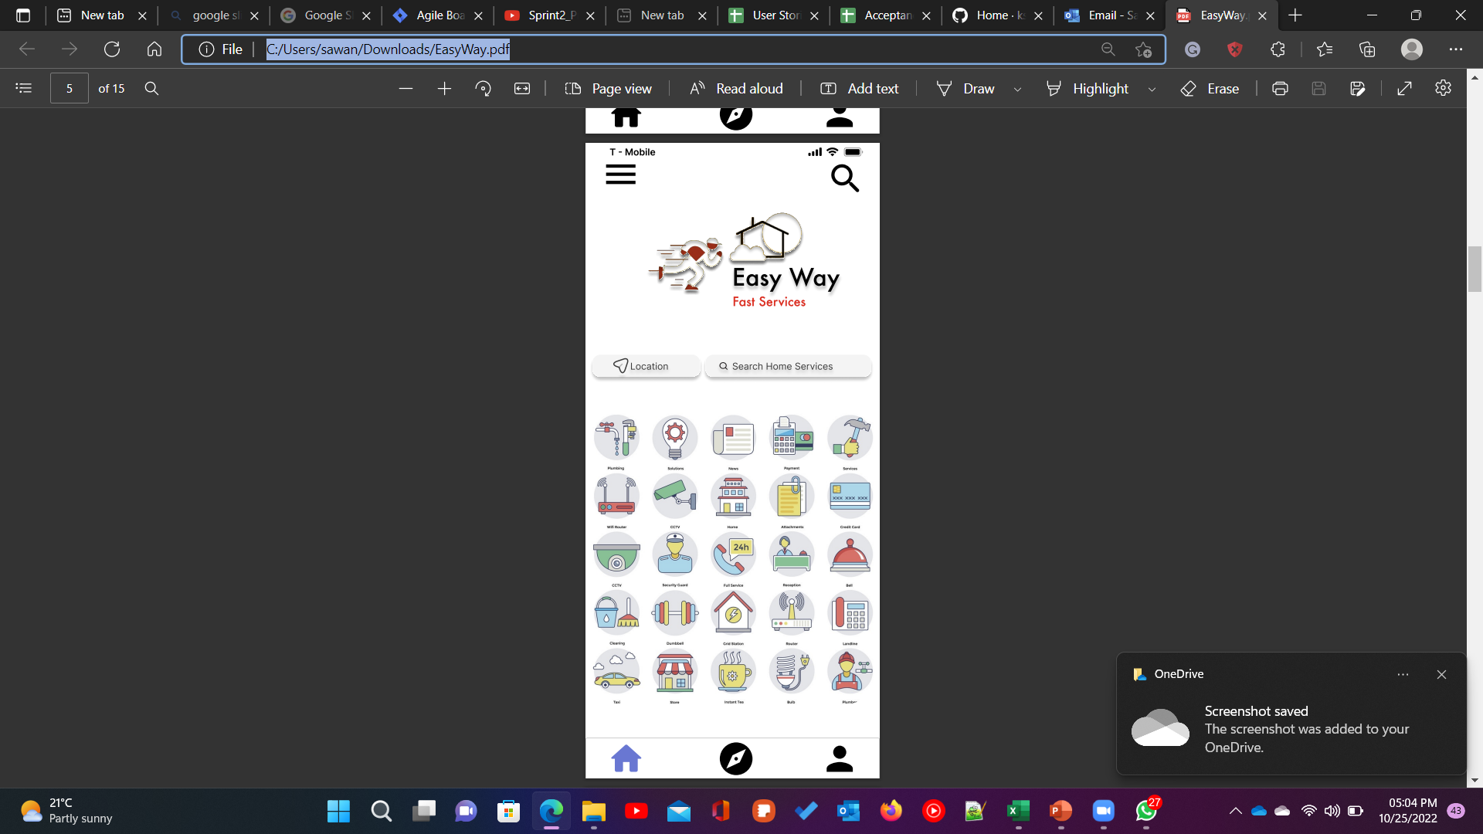
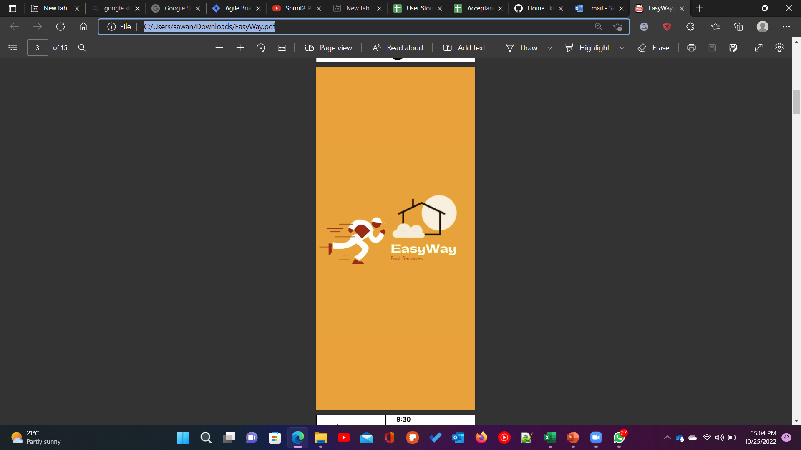
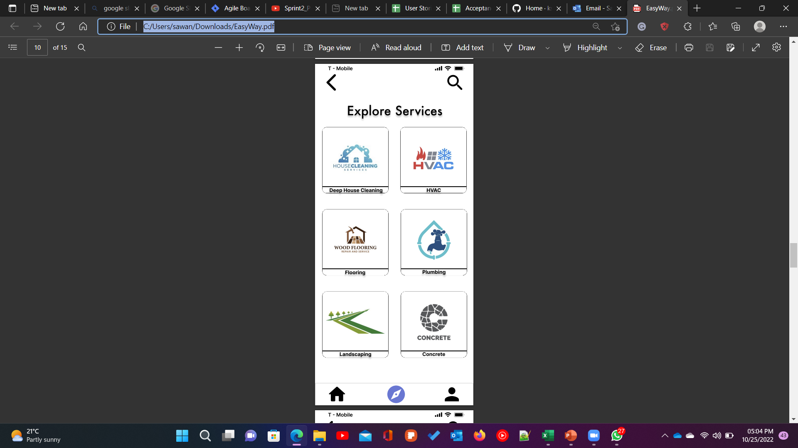
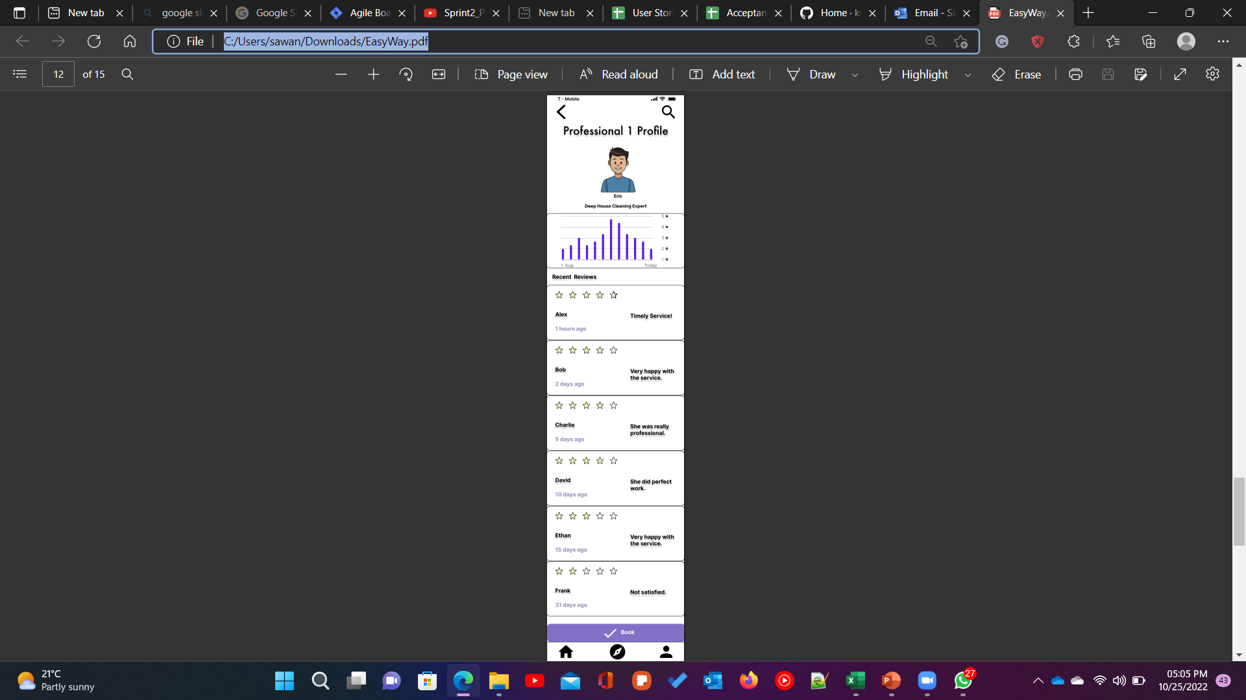
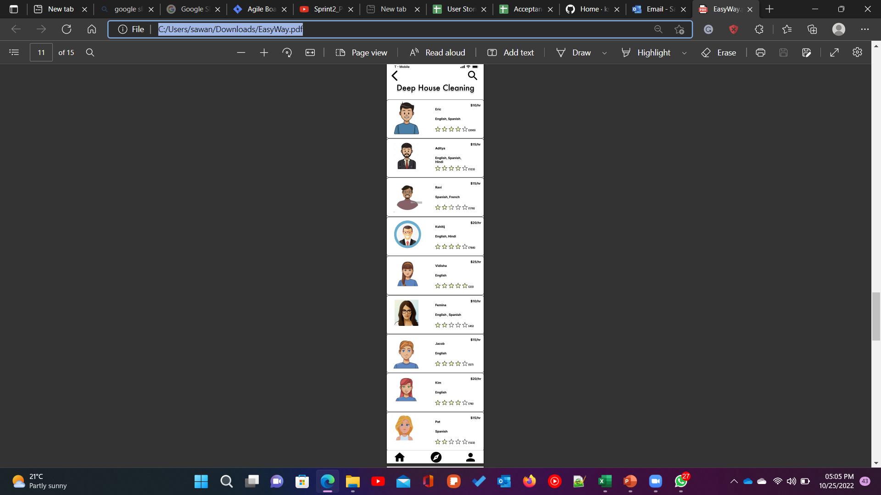
Minimal Viable Product (MVP)

Slide 16
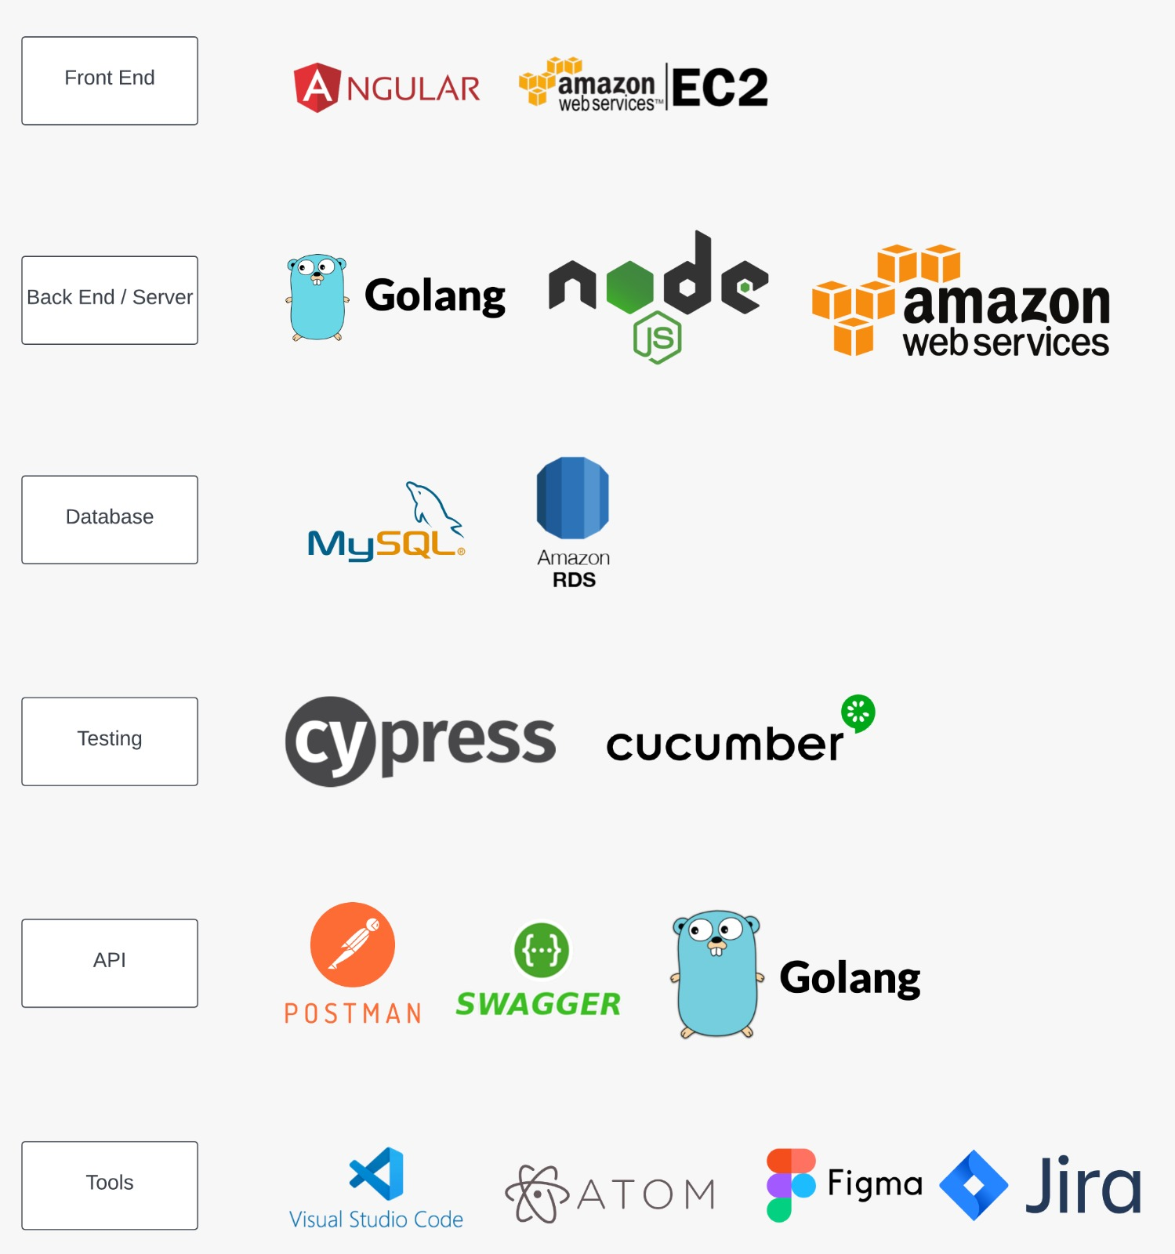
Technologies

Slide 17

Architecture Diagram

Slide 18

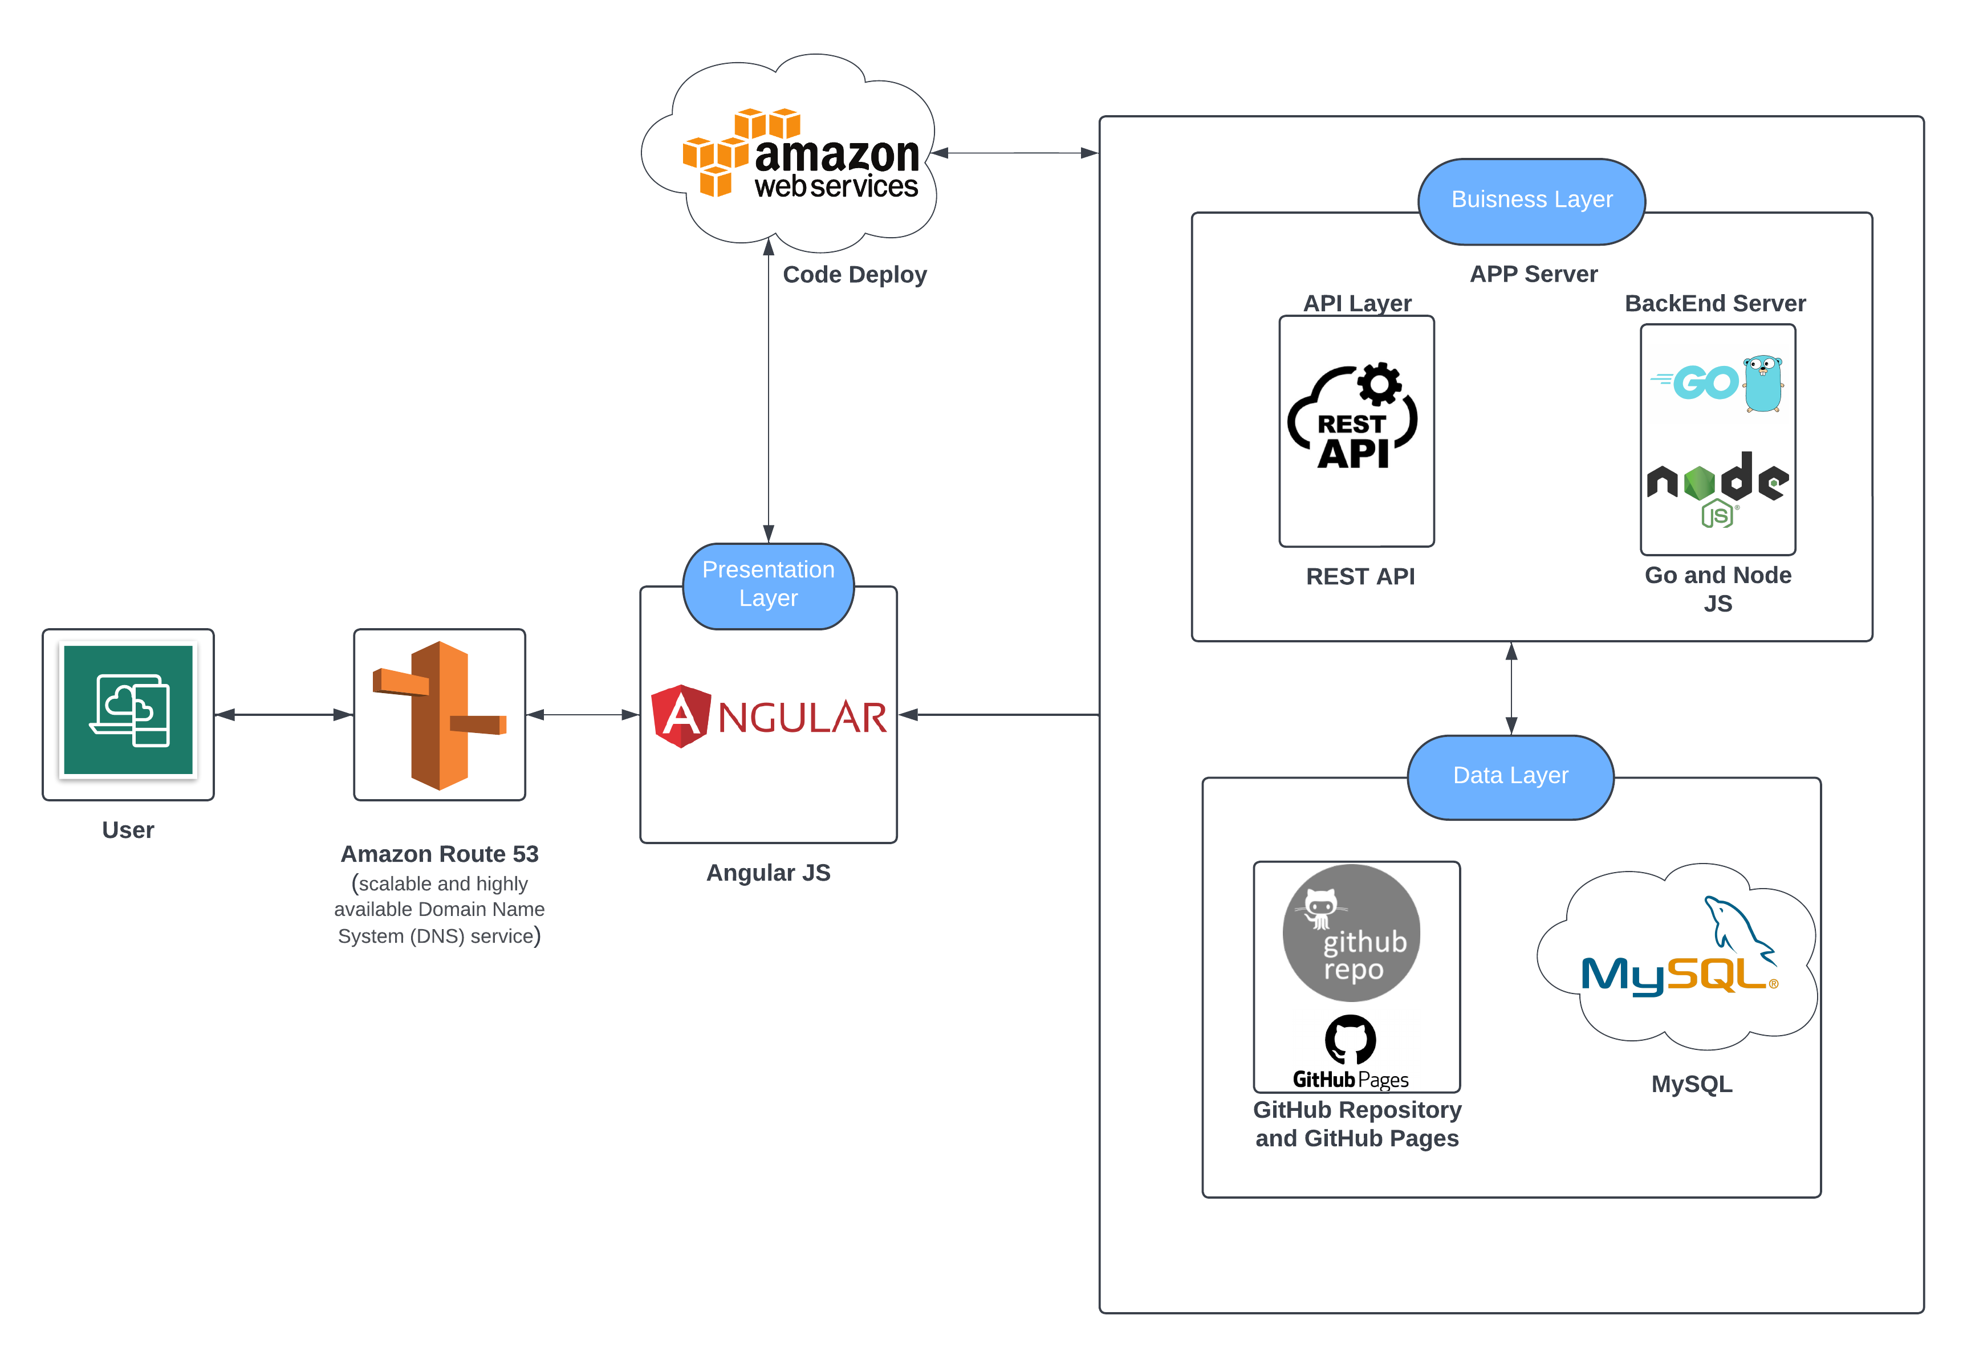
Conceptual Architecture Diagram

Slide 19
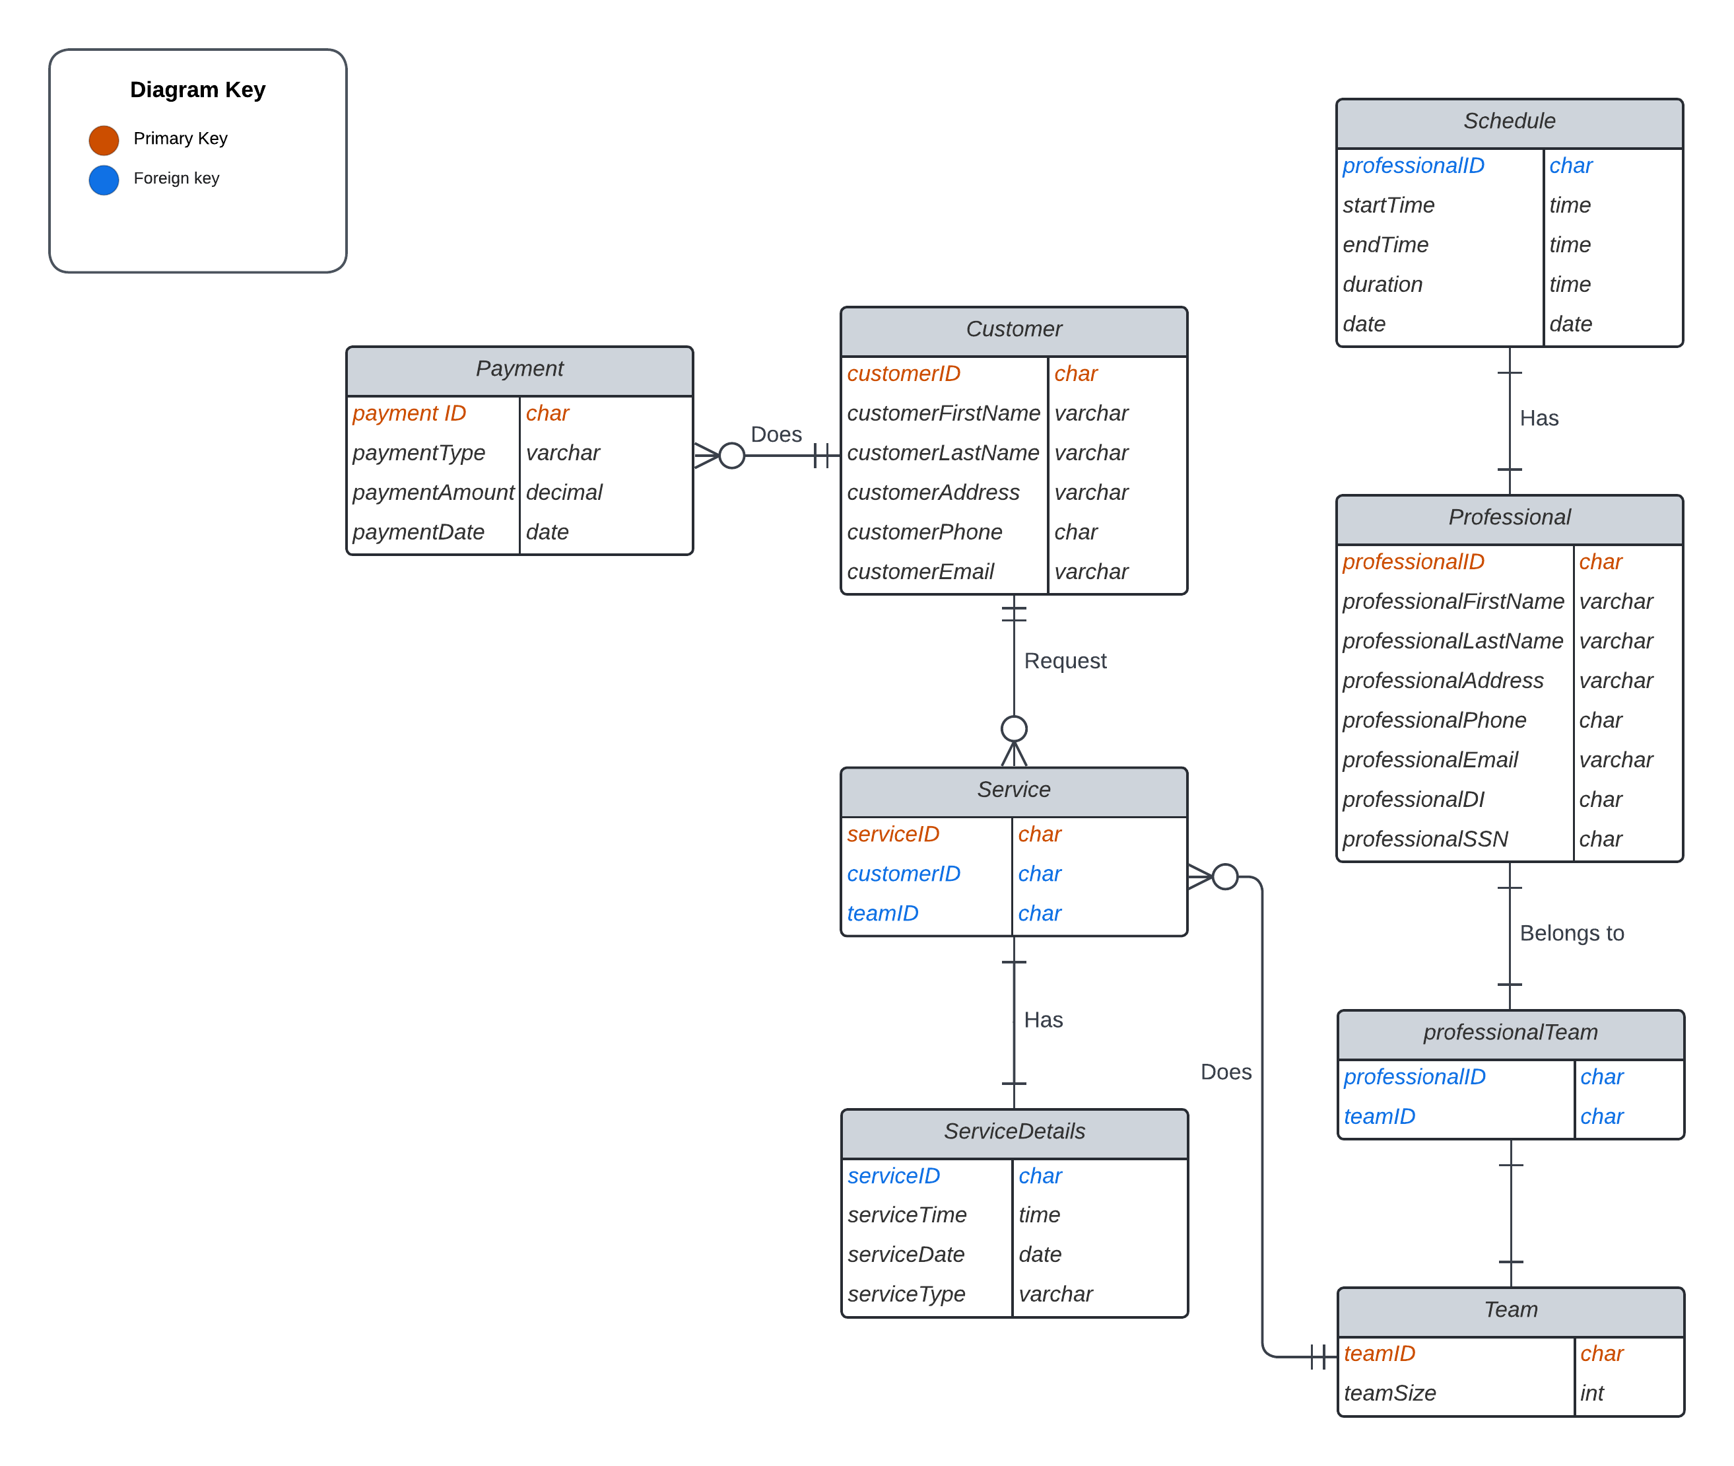
ERD Diagram

Slide 20
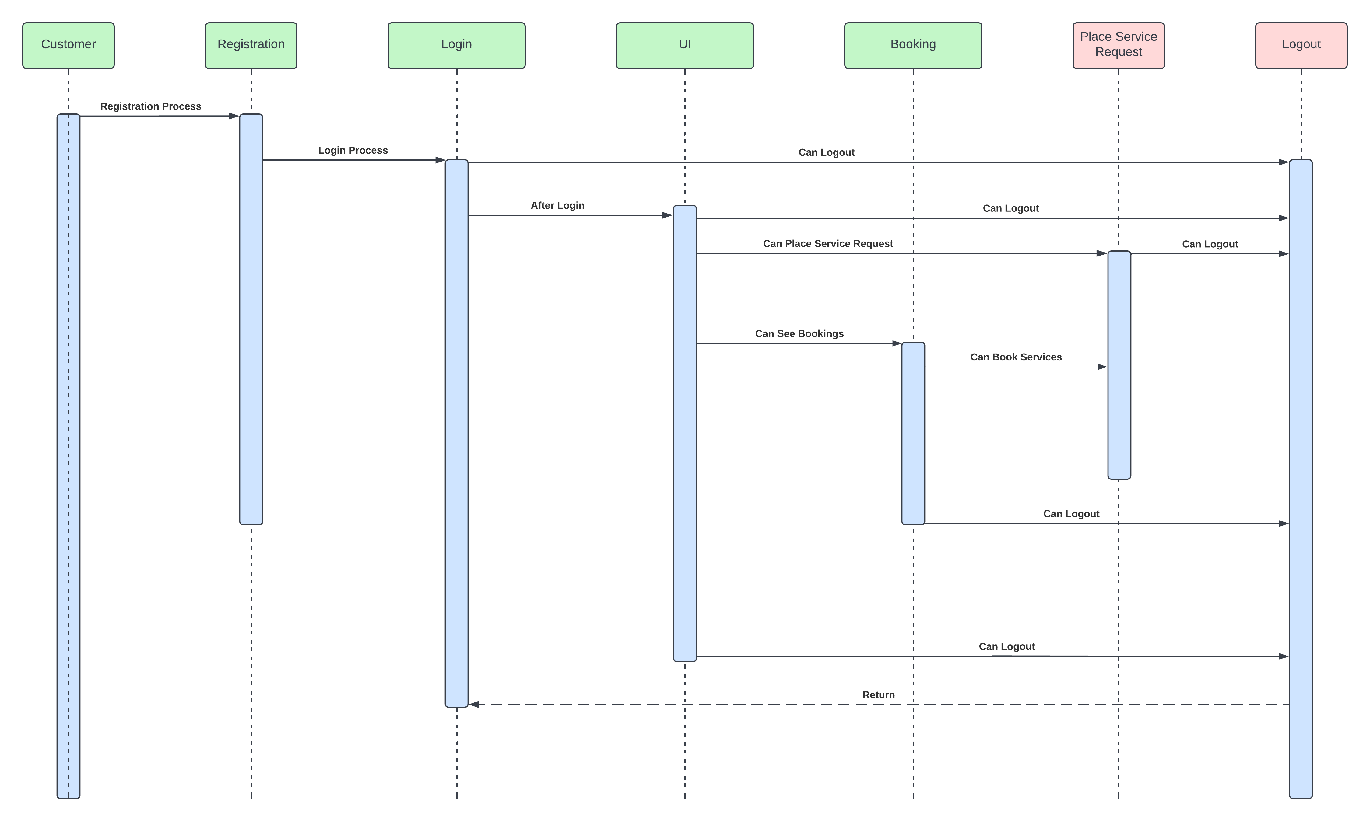
User Sequence Diagram

Slide 21
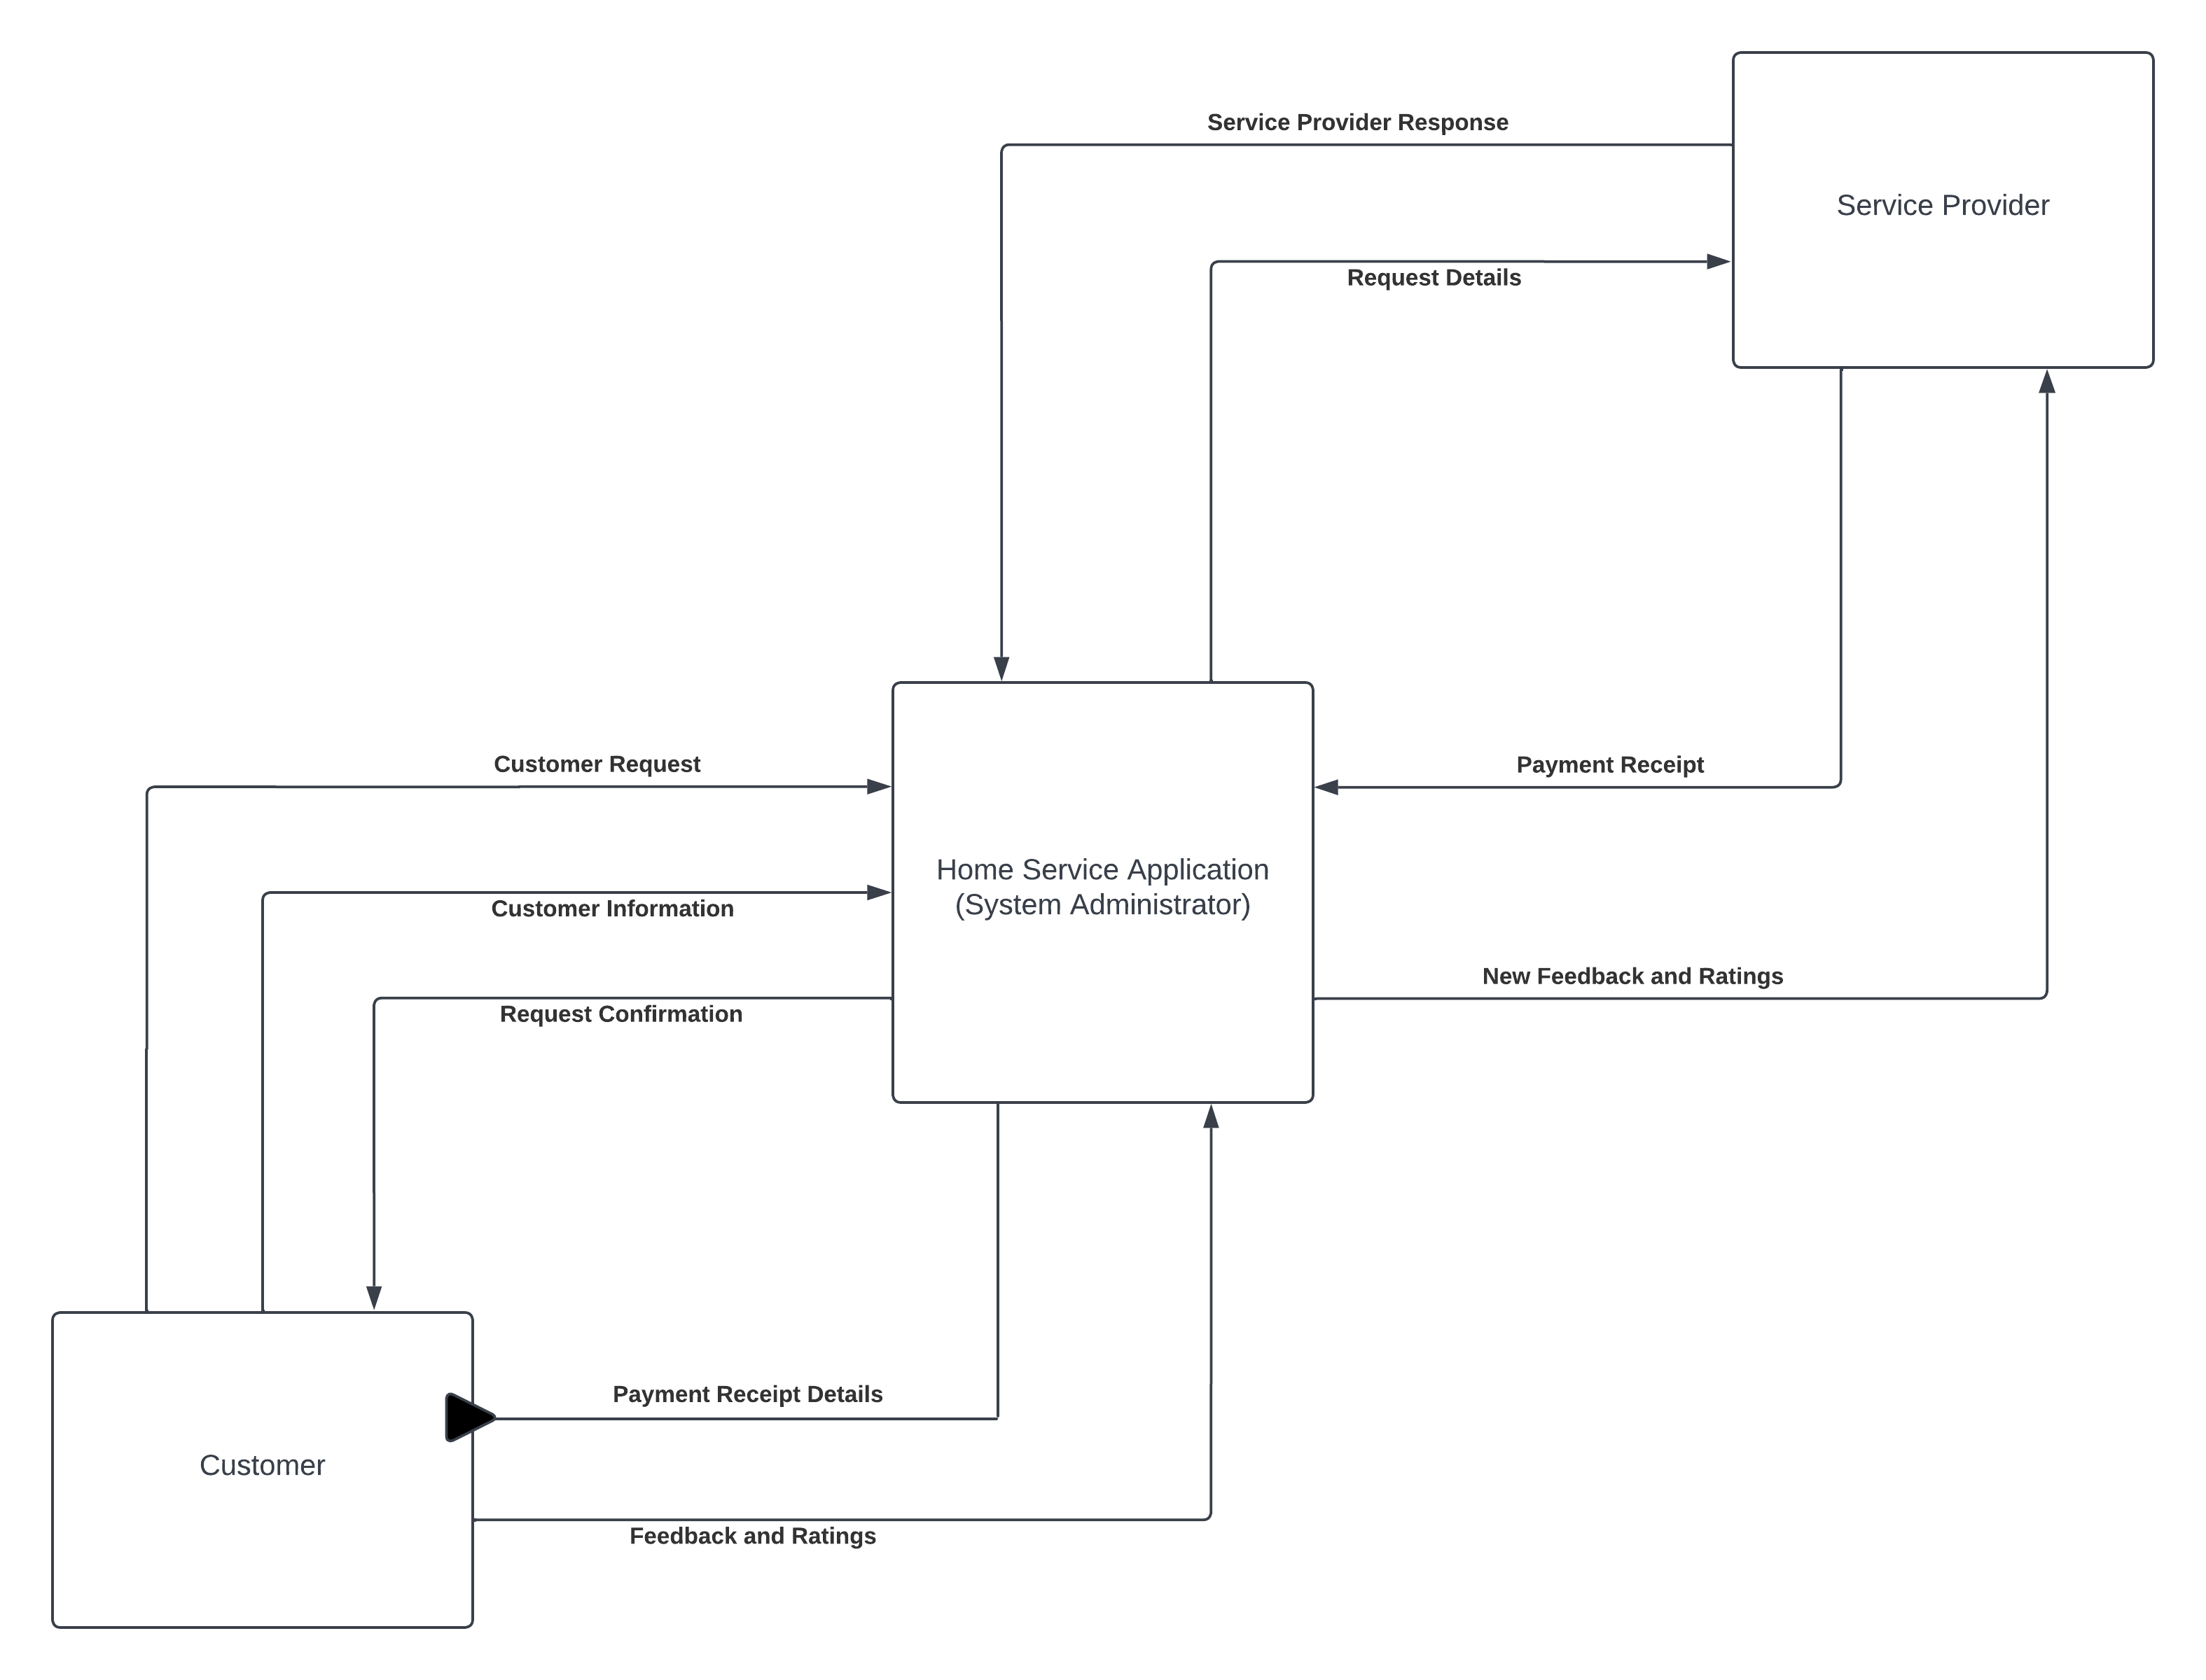
Dataflow Diagram Level 0

Slide 22

Sprint 3 Recap

Slide 23
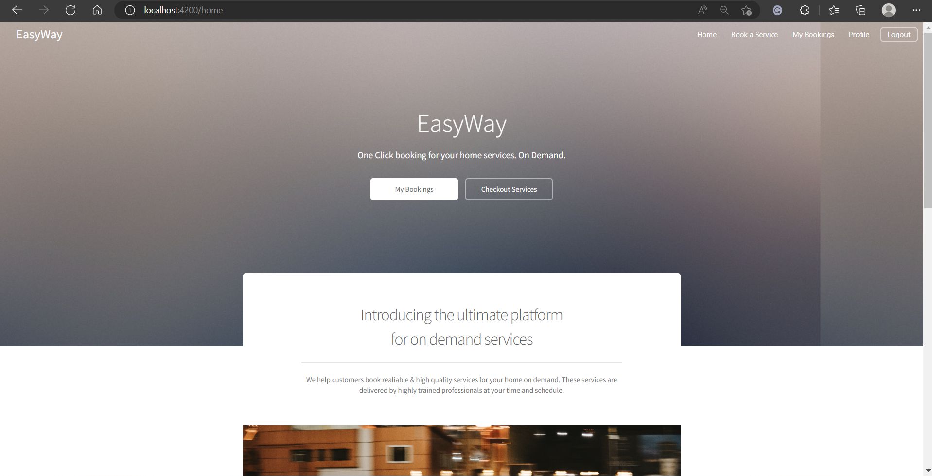
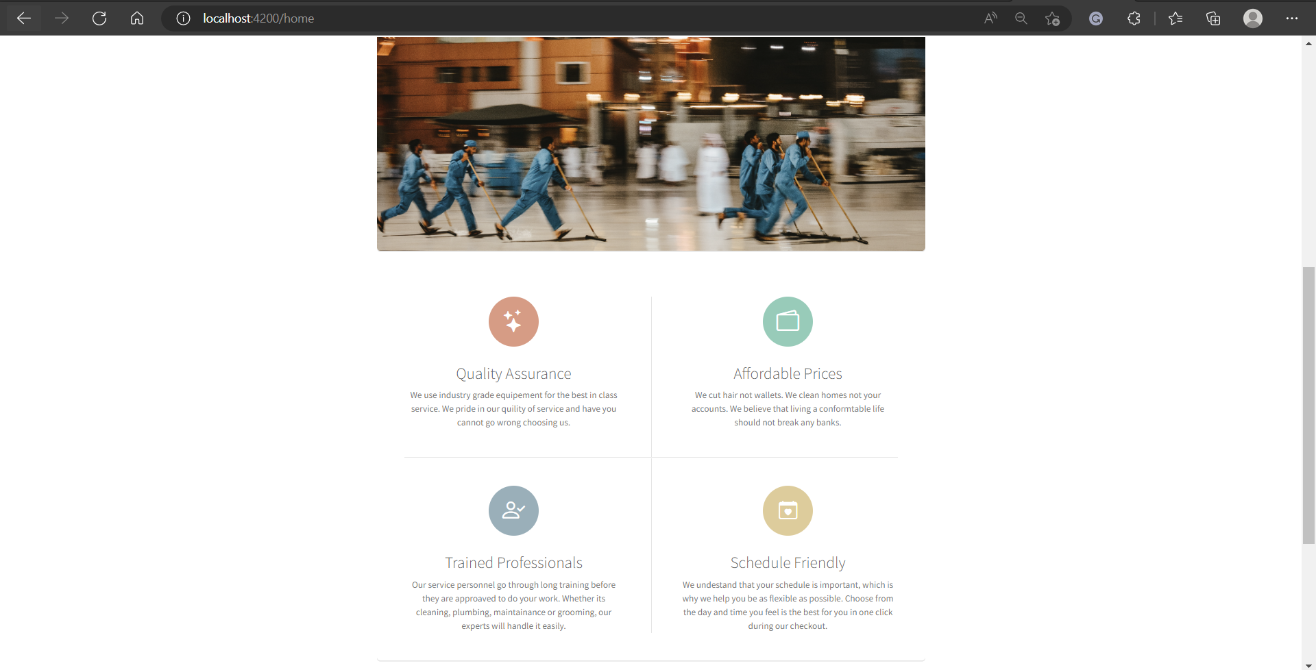
Homepage

Slide 24
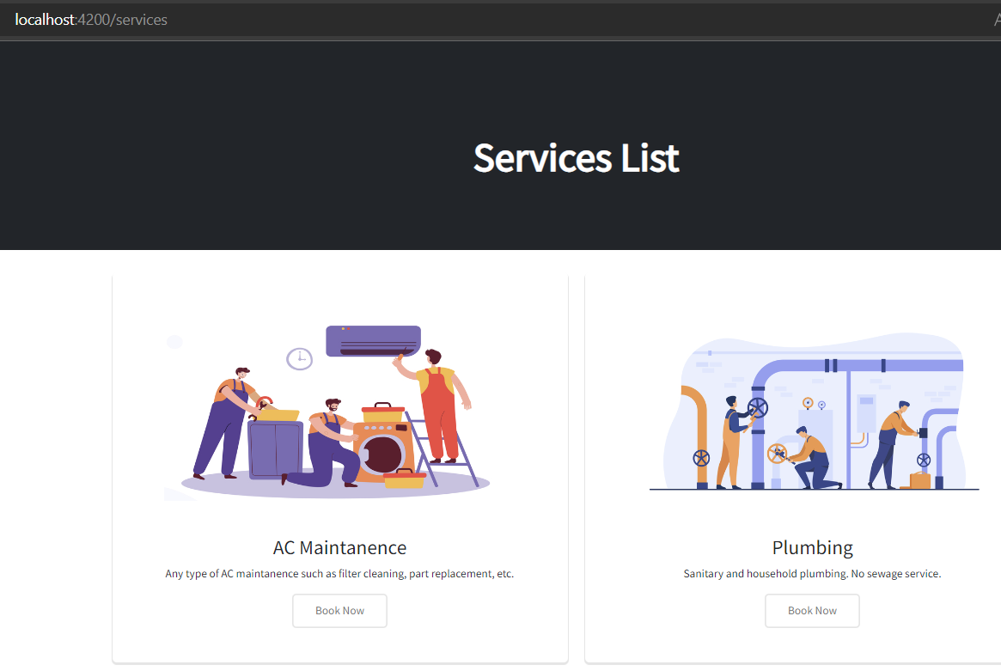
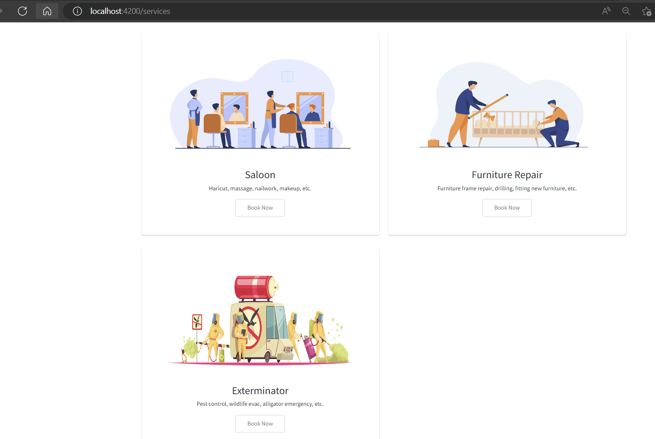
Service Catalog

Slide 25
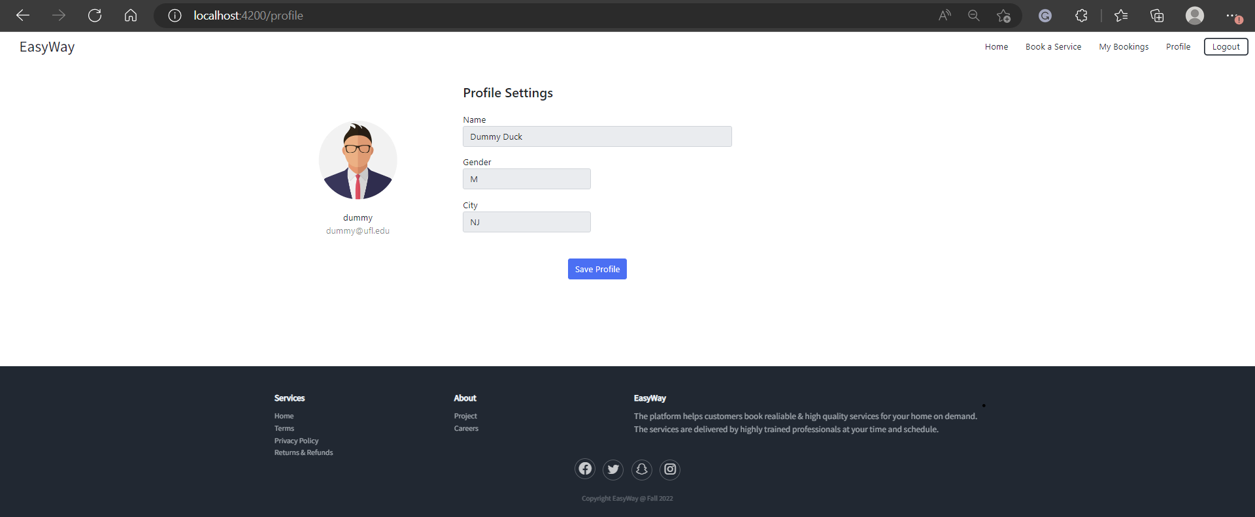
Customer Profile Page

Slide 26
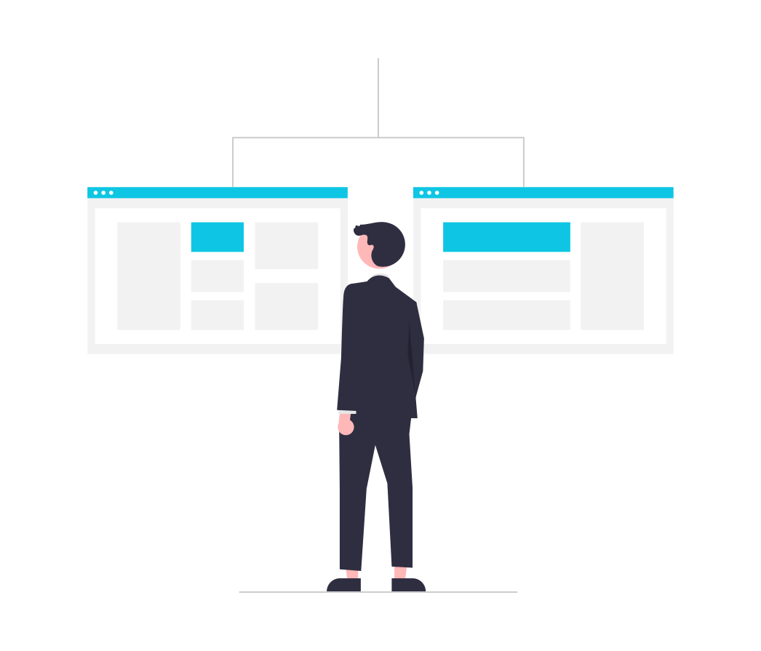
Sprint 3 vs Sprint 4
Homepage
Service Catalog
Customer Profile
Booking Page
Cancel Booking
Navigation Bar

Slide 27

Product Backlog
Issue Type | Key | Name
Story | DCS-45 | As a customer I want to browse all the professional home services provided. So that I have a list to select the service I want.
Story | DCS-41 | As a customer I want to able to submit feedback So that the website owners can consider my opinion or concern during future website updates
Story | DCS-40 | As a customer I want to able to access quick services near me So that I will be able to book in a urgent situation at my house.
Story | DCS-39 | As a customer I want to be access the services according to categories such as water, furniture, beauty, etc So that I will be able to access the see the services available and who the professionals are
Story | DCS-38 | As a customer I want to be directly able to contact the technician via call/text So that I will be able to have a better service
Story | DCS-37 | As a customer, I want to be able to prepone or postpone my booked service So that I can expect the professional on some other date or time.
Story | DCS-35 | As a customer, I want to be able to add multiple address So that I can use them to schedule a service for my office.
Story | DCS-33 | As a customer, I want to browse the service list So that I can get some information what does this particular service do.
Story | DCS-32 | As a signed-in customer I want to able to comment on a blog post So that I can get feedback on issues

Slide 28

Sprint Summary

Slide 29
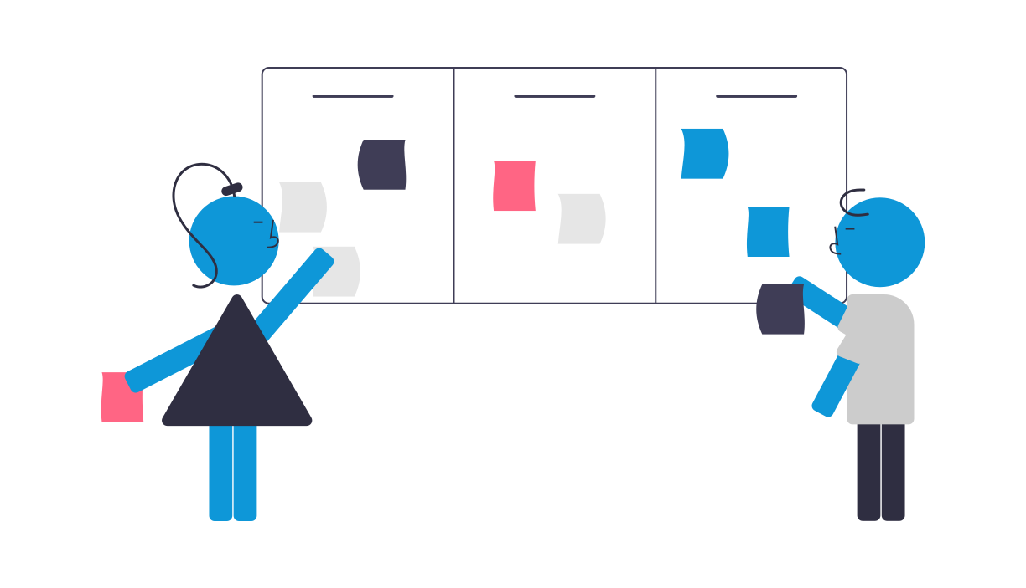
Sprint 1
Issue Type | Key | Name
Task | DCS-6 | Work on deliverable 1 presentation
Task | DCS-5 | Establish weekly meetings
Task | DCS-4 | Establish team roles
Task | DCS-3 | Setup development tools (GitHub and Jira)
Task | DCS-2 | Create a significant business application

Slide 30
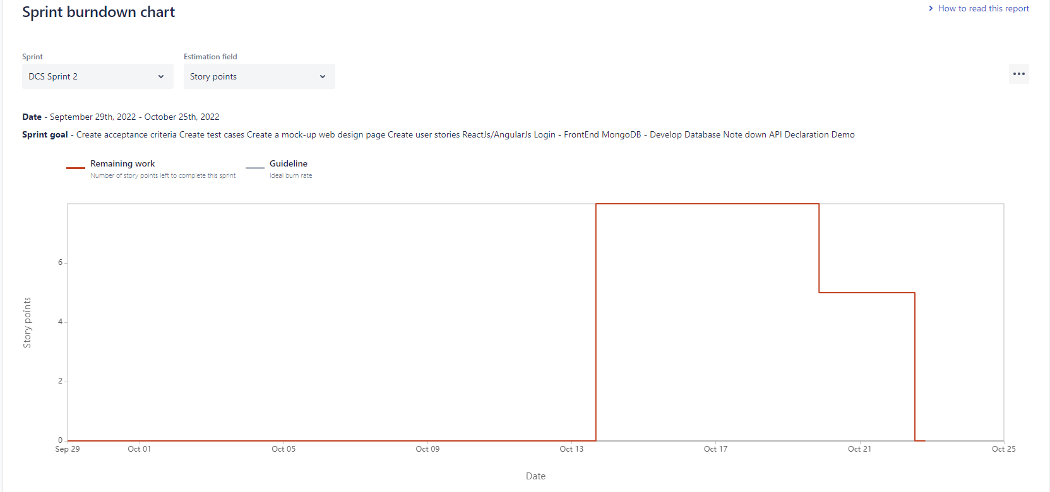
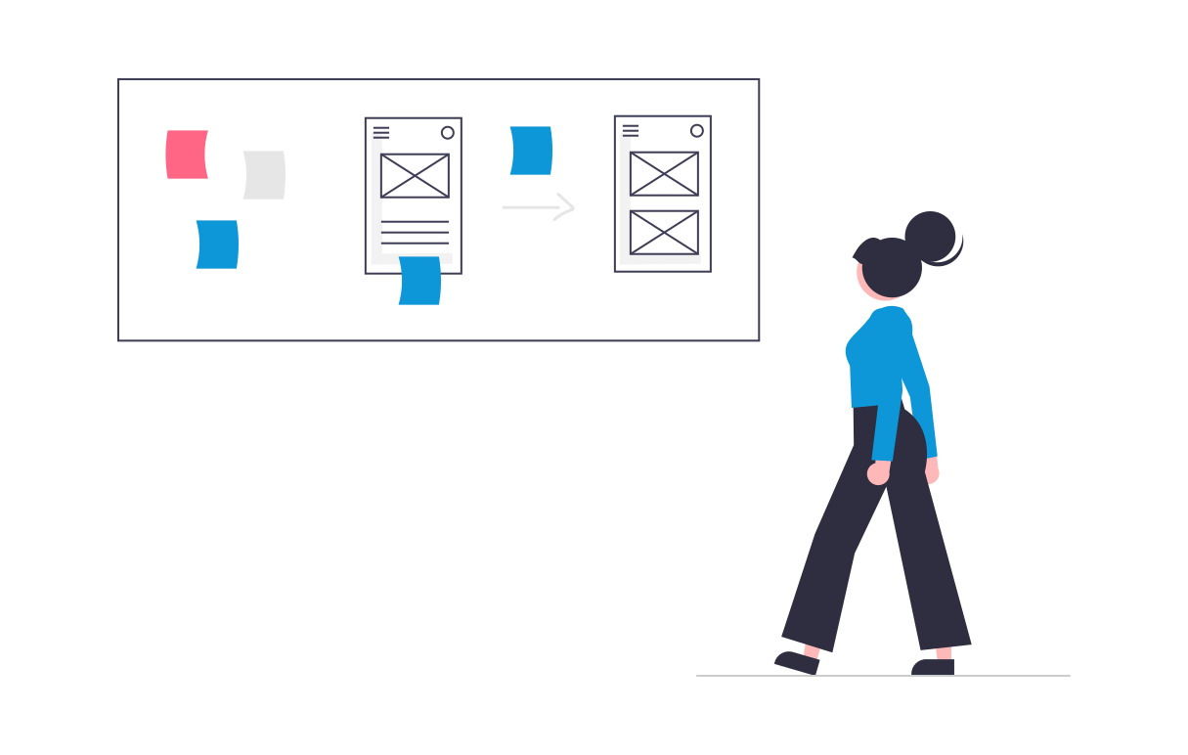
Sprint 2
Issue Type | Key | Name | Story Points Estimate
Story | DCS-14 | As a signed-in customer, I want to log out So that I can have my privacy in the app. | 3
Story | DCS-13 | As a customer, I want to register myself to the application So that I can keep my account private and login using email/phone and password. | 5
Story | DCS-12 | As a customer, I want to login into the app, So that I can use it to store all my information. | 5
Task | DCS-10 | Create MVP Prototype - Figma | 3

Slide 31
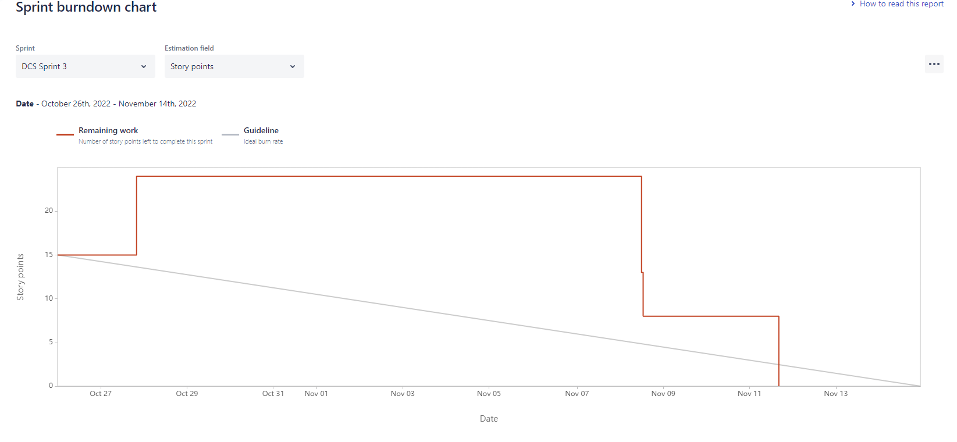
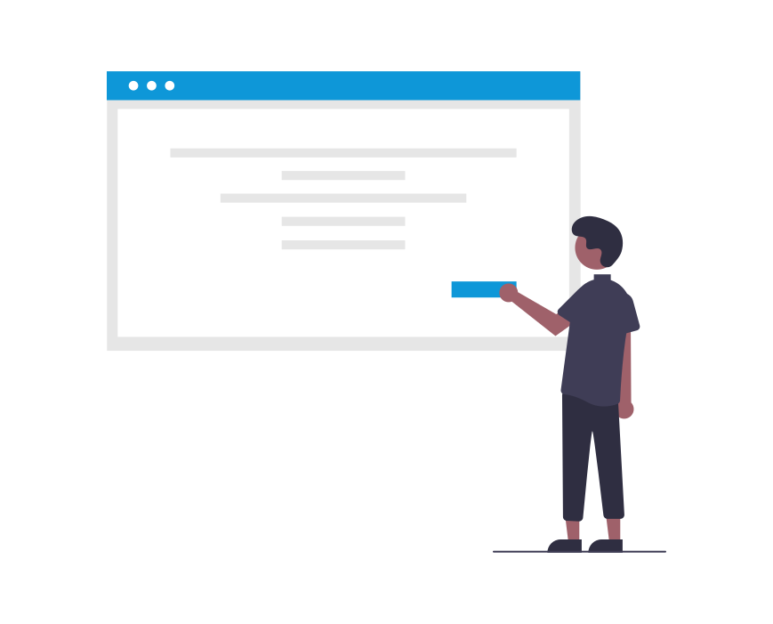
Sprint 3
Issue Type | Key | Summary | Story Point Estimate
Story | DCS-51 | As a customer, I want to browse all the services provided by the app, So that I have a list of professionals to select from and book them accordingly. | 3
Story | DCS-49 | As a customer, I want to create my profile, So that I can store my Name, Address, and Phone No. in it. | 5
Story | DCS-48 | As a customer, I want to browse the service list, So that I will be able to see what services this app offers. | 3
Story | DCS-18 | As a customer, I would like to have a landing page explaining all the features of the platform, So that I am motivated to register. | 5
Task | DCS-17 | Draft Technical Paper | 8

Slide 32
Sprint 4 Backlog / Sprint Backlog
Issue Type | Key | Name | Story Points Estimate
Story | DCS-52 | As a customer, I want a navigation bar to go between pages, log in and out, and search for specific events so that I may use the app more effectively. | 3
Story | DCS-50 | As a customer, I want to see the services booked by me so that I can track them. | 5
Story | DCS-24 | As a customer, I want to be able to cancel my booked service so that I can not expect the professional to reach my home. | 5
Story | DCS-23 | As a customer, I want to choose the date and time of service, so it is available at my convenience. | 5
Task | DCS-26 | Finish Technical Paper | 8

Slide 33

User Stories and Acceptance Criteria

Slide 34
User Stories And Acceptance Criteria
User Story ID | Summary | Status | Place
DCS-24 | As a customer, I want to be able to cancel my booked service So that I can not expect the professional to reach my home. | Done | Booking
 | Scenario: customer want to cancel a booking “Given I’m in a role of logged-in customer When I open the Booking History page Then the system shows me the confirmation tab for cancelling And when I click on Yes it should cancel my booked service.
DCS-50 | As a customer, I want to see the services booked by me So that I can track it. | Done | Booking History
 | Scenario: Customer wants to track the appointment "Given I'm a logged-in customer When already scheduled an appointment Then I would be able to track the appointment date and time of the booking along with details of the technician.
DCS-52 | As a customer, I want a navigation bar to go between pages, login and out, and search for specific events So that I may use the app more efficiently | Done | Navigation
 | Scenario: Customer wants to navigate between pages “Given I’m in the role of a guest customer When I click on any tab on the header of the Landing Page Then the system should redirect me toward the clicked tab And the redirect page should be loaded.
DCS-23 | As a customer, I want to choose the date and time of the service So that it is available at my convenience | Done | Booking
 | Scenario: Customer wants to see the available date and time “Given I’m in the role of guest customer When I open the services catalog page Then I click on one of the services it redirects me to the booking page And I should be able to see the available dates and times to book.

Slide 35
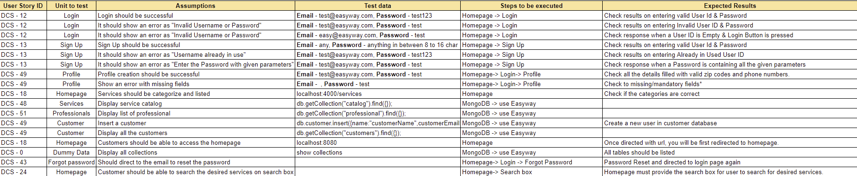
Testcases

Slide 36
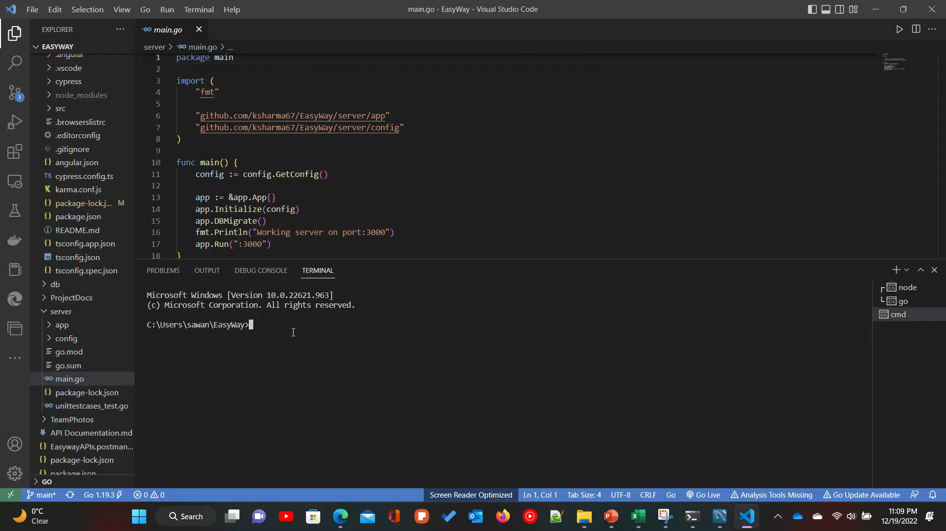
Integration Testing on MVP

Slide 37
Stories Completed and Stories not completed
Issue Type | Key | Name | Status
Story | DCS-52 | As a customer, I want a navigation bar to go between pages, log in and out, and search for specific events so that I may use the app more effectively. | Done
Story | DCS-50 | As a customer, I want to see the services booked by me so that I can track them. | Done
Story | DCS-24 | As a customer, I want to be able to cancel my booked service so that I can not expect the professional to reach my home. | Done
Story | DCS-23 | As a customer, I want to choose the date and time of service, so it is available at my convenience. | Done
Task | DCS-26 | Finish Technical Paper | Done

Slide 38

Metrics

Slide 39
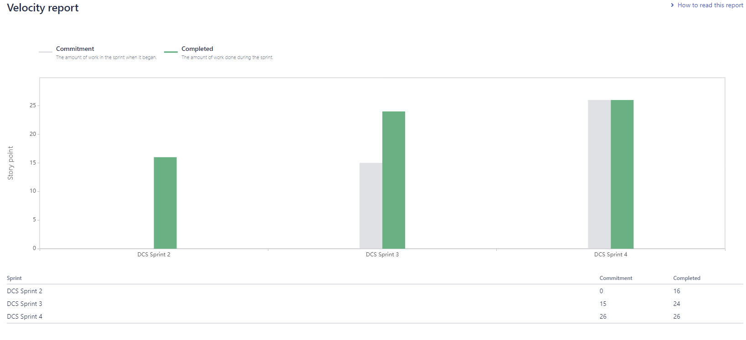
Team Velocity Chart

Slide 40
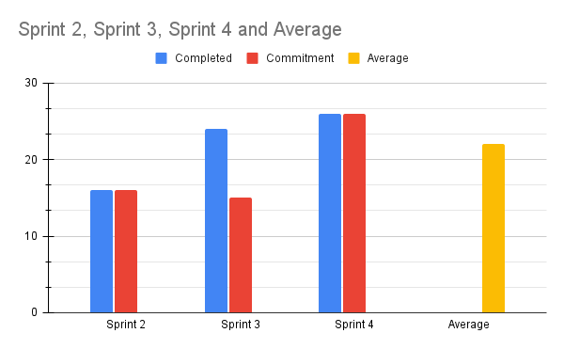
Team History Velocity

Slide 41
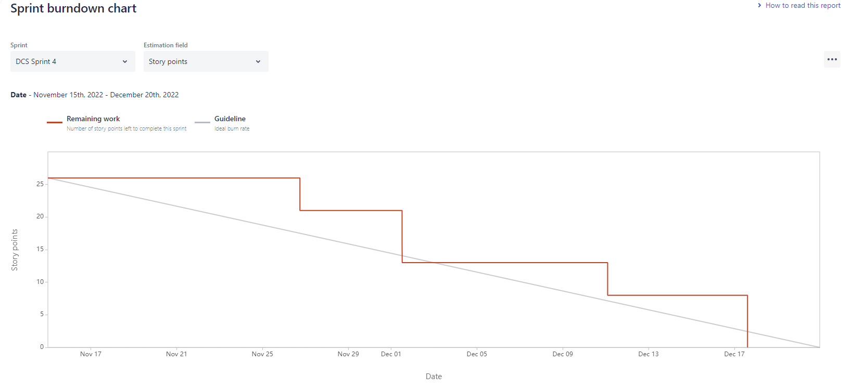
Burndown Chart

Slide 42
Committed / Completed Ratio

Slide 43
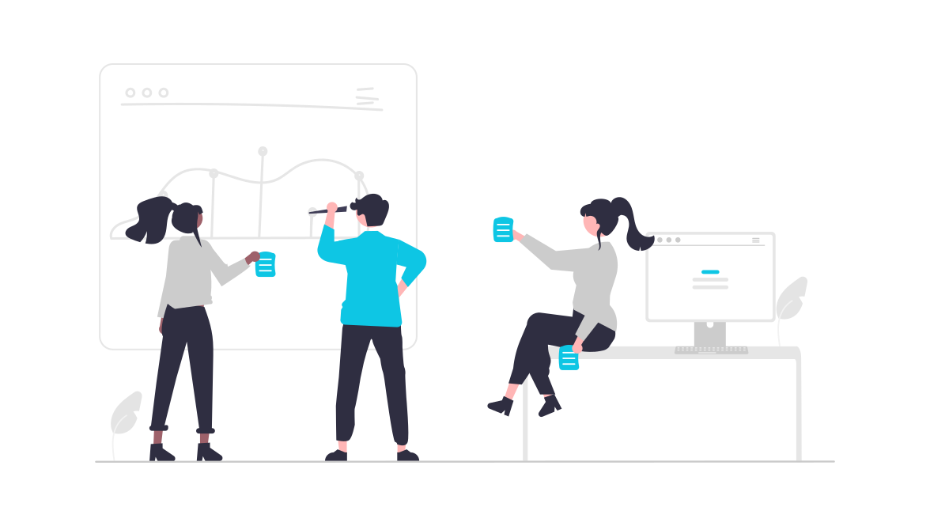
Retrospective

Slide 44
What Went Well
Division of tasks was overall done well, with regards to Frontend and Backend.
Completing our work on time.
Using GitHub as our code collaboration tool and netlify as our cloud hosting provider.
Unit Testing and Integration Testing were done with a 100% passing score.

Slide 45
What Needs Improvement
Team Engagement was low.
Communication was occasionally lacking such as unanswered messages on Slack and WhatsApp
The retrospective should be noted by each team member within the sprint using stickies/ miro board.

Slide 46
Next Steps
Team members need to take more initiative.
Establish a better availability window for meetings.
Sprint-planned items need to be enforced to avoid mid-sprint scope changes.
We need to work on stories and tasks in a timely manner.

Slide 47
Sprint 5
Issue Type | Key | Name | Story Points Estimate
Task | DCS-57 | Research on image classification ML algorithms | 8
Story | DCS-46 | As a customer, I want to email customer service So that I can get my issue resolved | 3
Story | DCS-44 | As a customer I want to able to recover the passwords to my account So that I will be able to access my account in case i forgot password. | 3
Story | DCS-43 | As a customer I want to be able to recover my account customer ID/Name So that I will be able to access my account in case i forgot the account. | 5
Story | DCS-42 | As a customer, I want to able to search on the webpage, So that I can find necessary information | 5

Slide 48

Project Demo Sprint 4

Slide 49

Slides App Screenshot

Slide 50
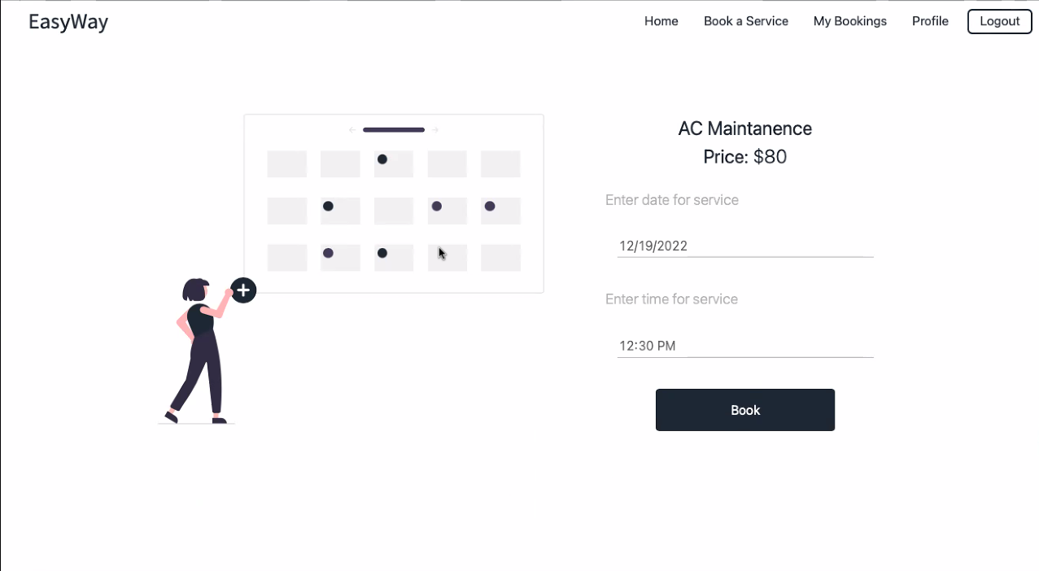
Booking Page

Slide 51
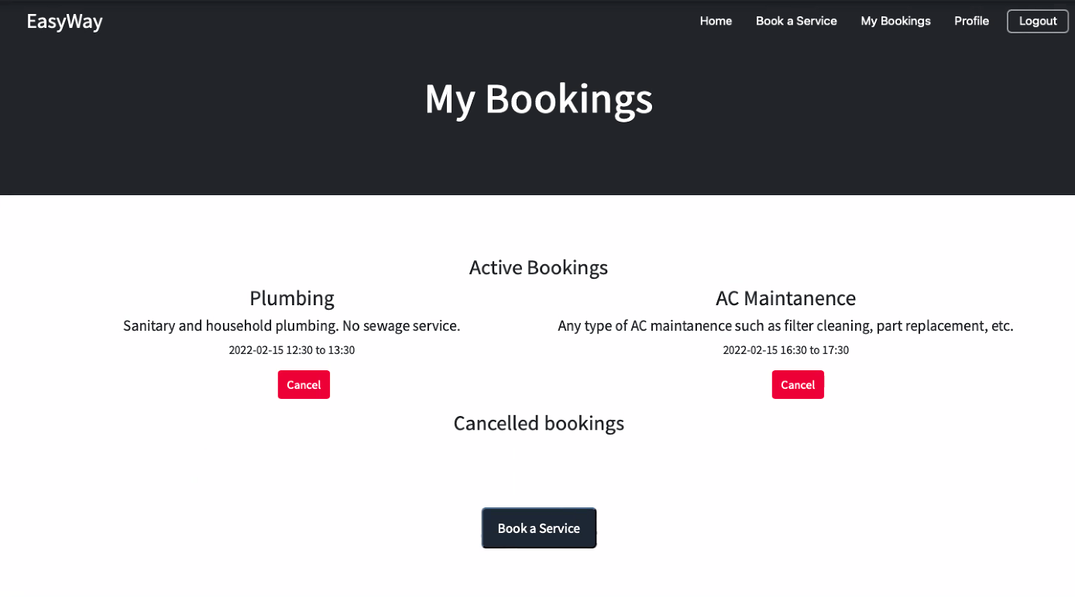
Booking Page

Slide 52
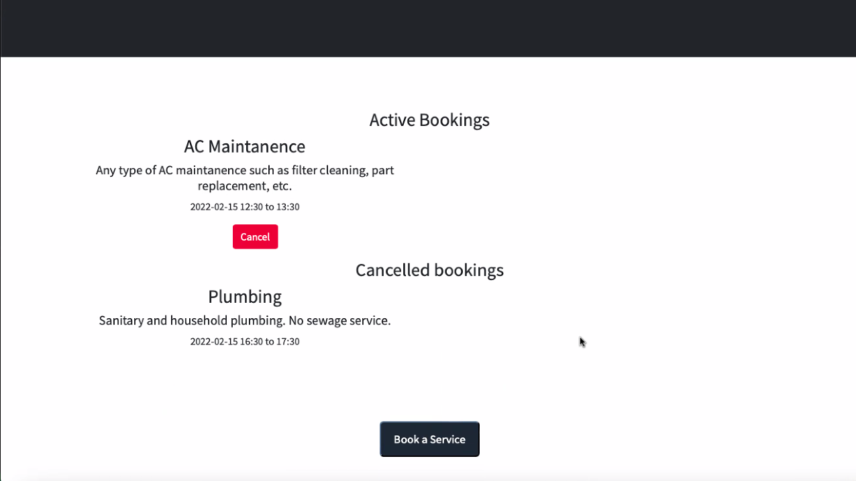
Cancel Booking

Slide 53
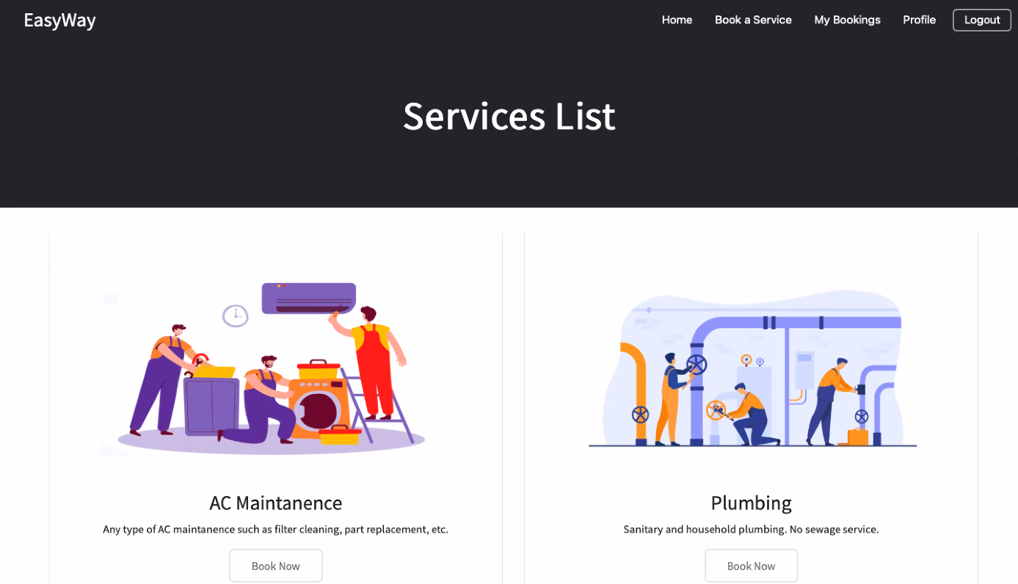
Navigation Bar

Slide 54
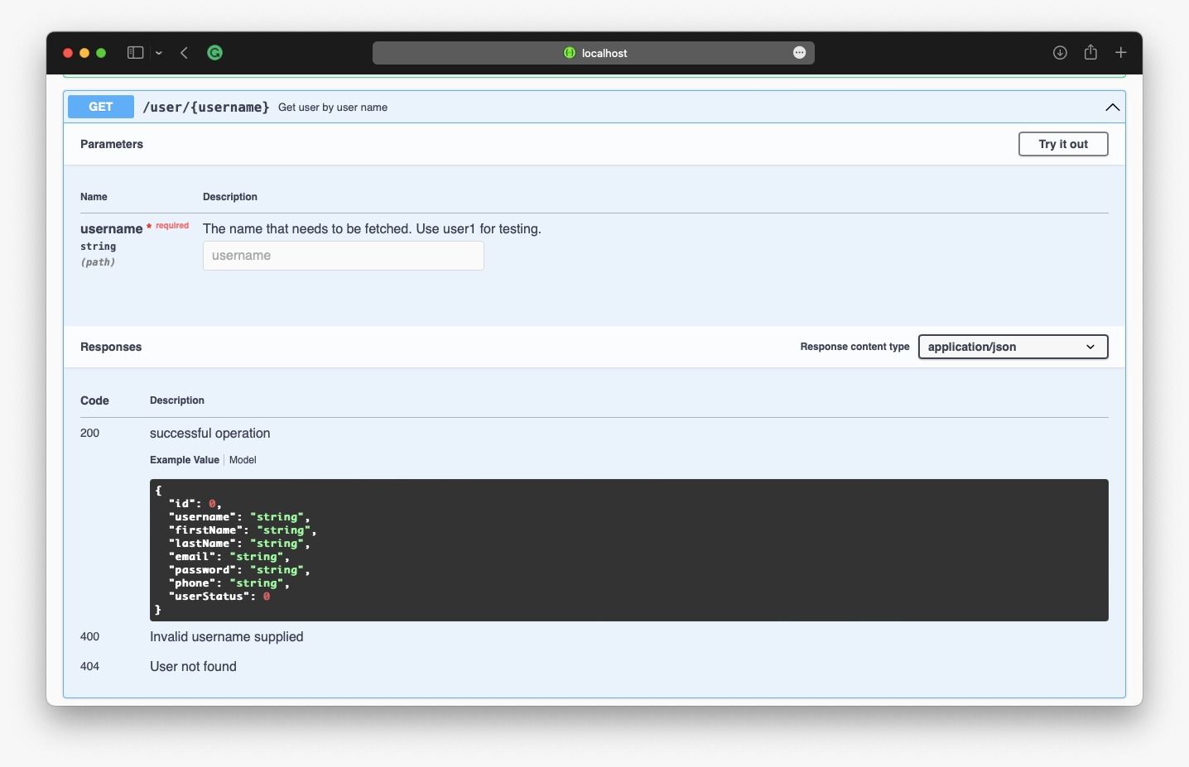
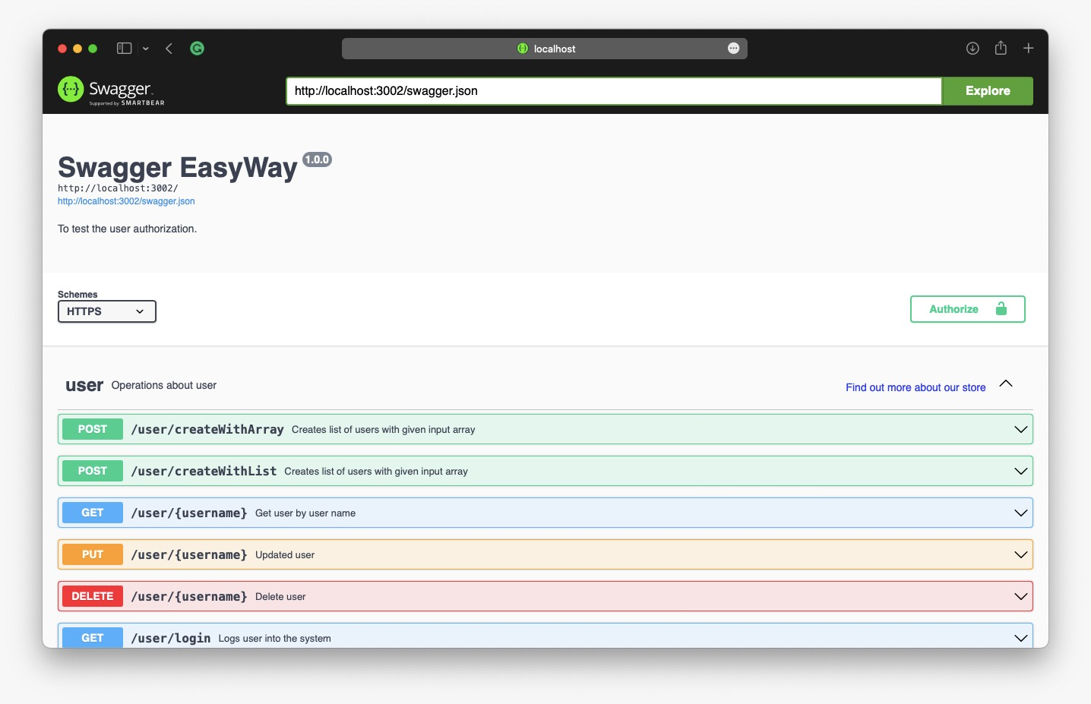
Slides for API

Slide 55

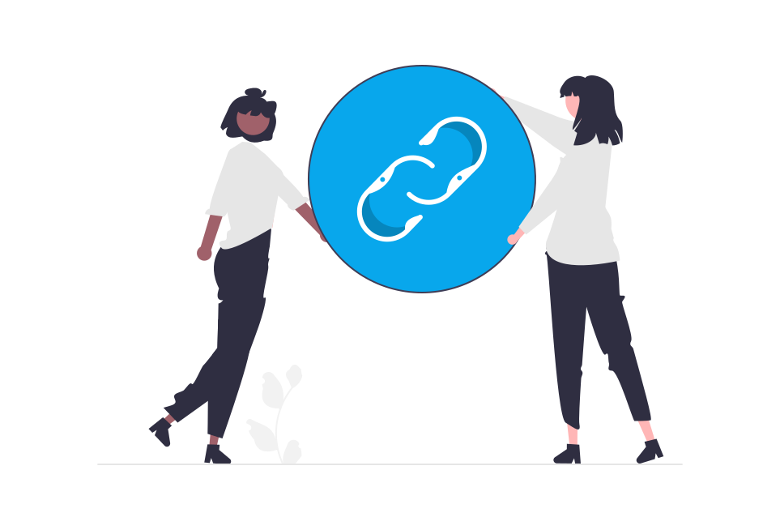
GitHub Link
Home · ksharma67/EasyWay Wiki (github.com)
Technical Paper Link
EASYWAY TECHNICAL PAPER (GITHUB.COM)
Installation Manual Link
EasyWay/Installation Manual.pdf at main · ksharma67/EasyWay (github.com)
API Documentation
EasyWay/API Documentation.pdf at main · ksharma67/EasyWay (github.com)

Slide 56

Live Application Demo

Slide 57
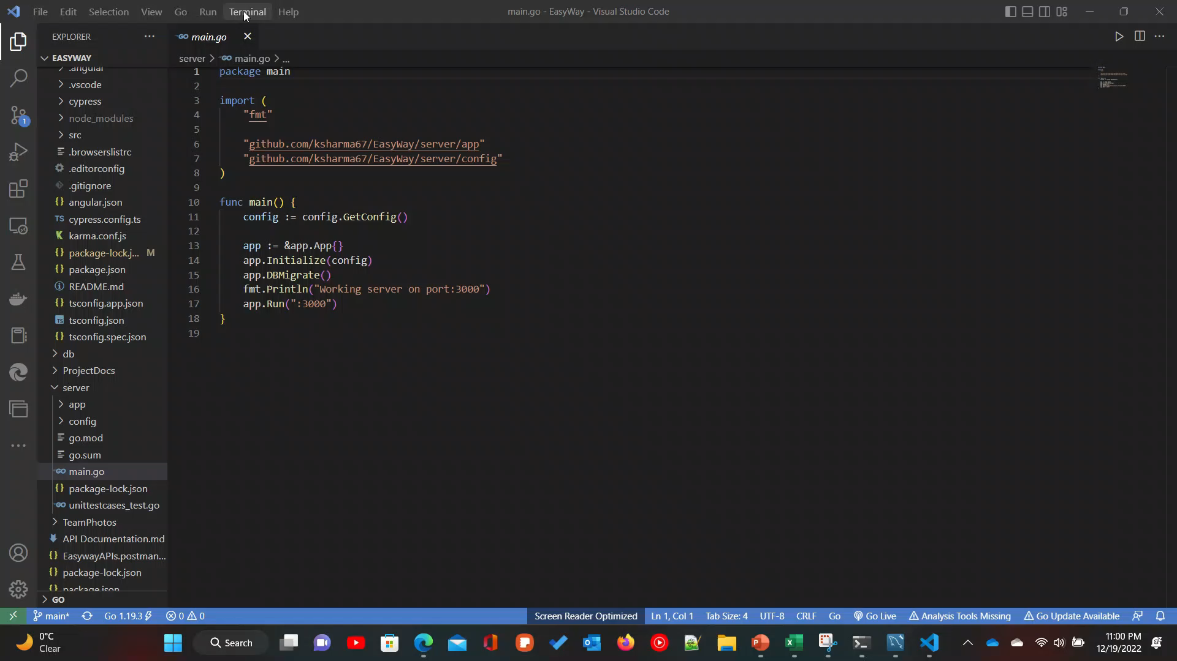
Live Application Demo

Slide 58

Thank You

